Slide 1
Chelan County Climate Resilience Strategy Document
Shawn Seaman, Chelan PUD
Mike Kaputa, Chelan County Natural Resources Dept.
Notes:
AFTER TRACY AND MIKE, SWITCH TO SNOVER SLIDES

Slide 2
Background and Purpose
Purpose
This document is meant to help understand how climate change will impact Chelan County by answering the following questions:
Where are we heading based on current trends and expected changes?
What does that mean for commerce, communities, residents of Chelan County as well as visitors?
What are steps Chelan County and the greater community can take to build climate resilience?

Slide 3
Background and Purpose
Purpose
Document meant to help achieve two key benefits of county-wide climate resilience planning:
Improve communication and coordination for climate resilience efforts
Identify opportunities to advance projects that provide multiple benefits for organizations, people, and agencies in Chelan County
Building climate resilience is...
“Being prepared for, and adapting to, current and future climate-related changes.”
–WA DNR Plan for Climate Resilience

Slide 4
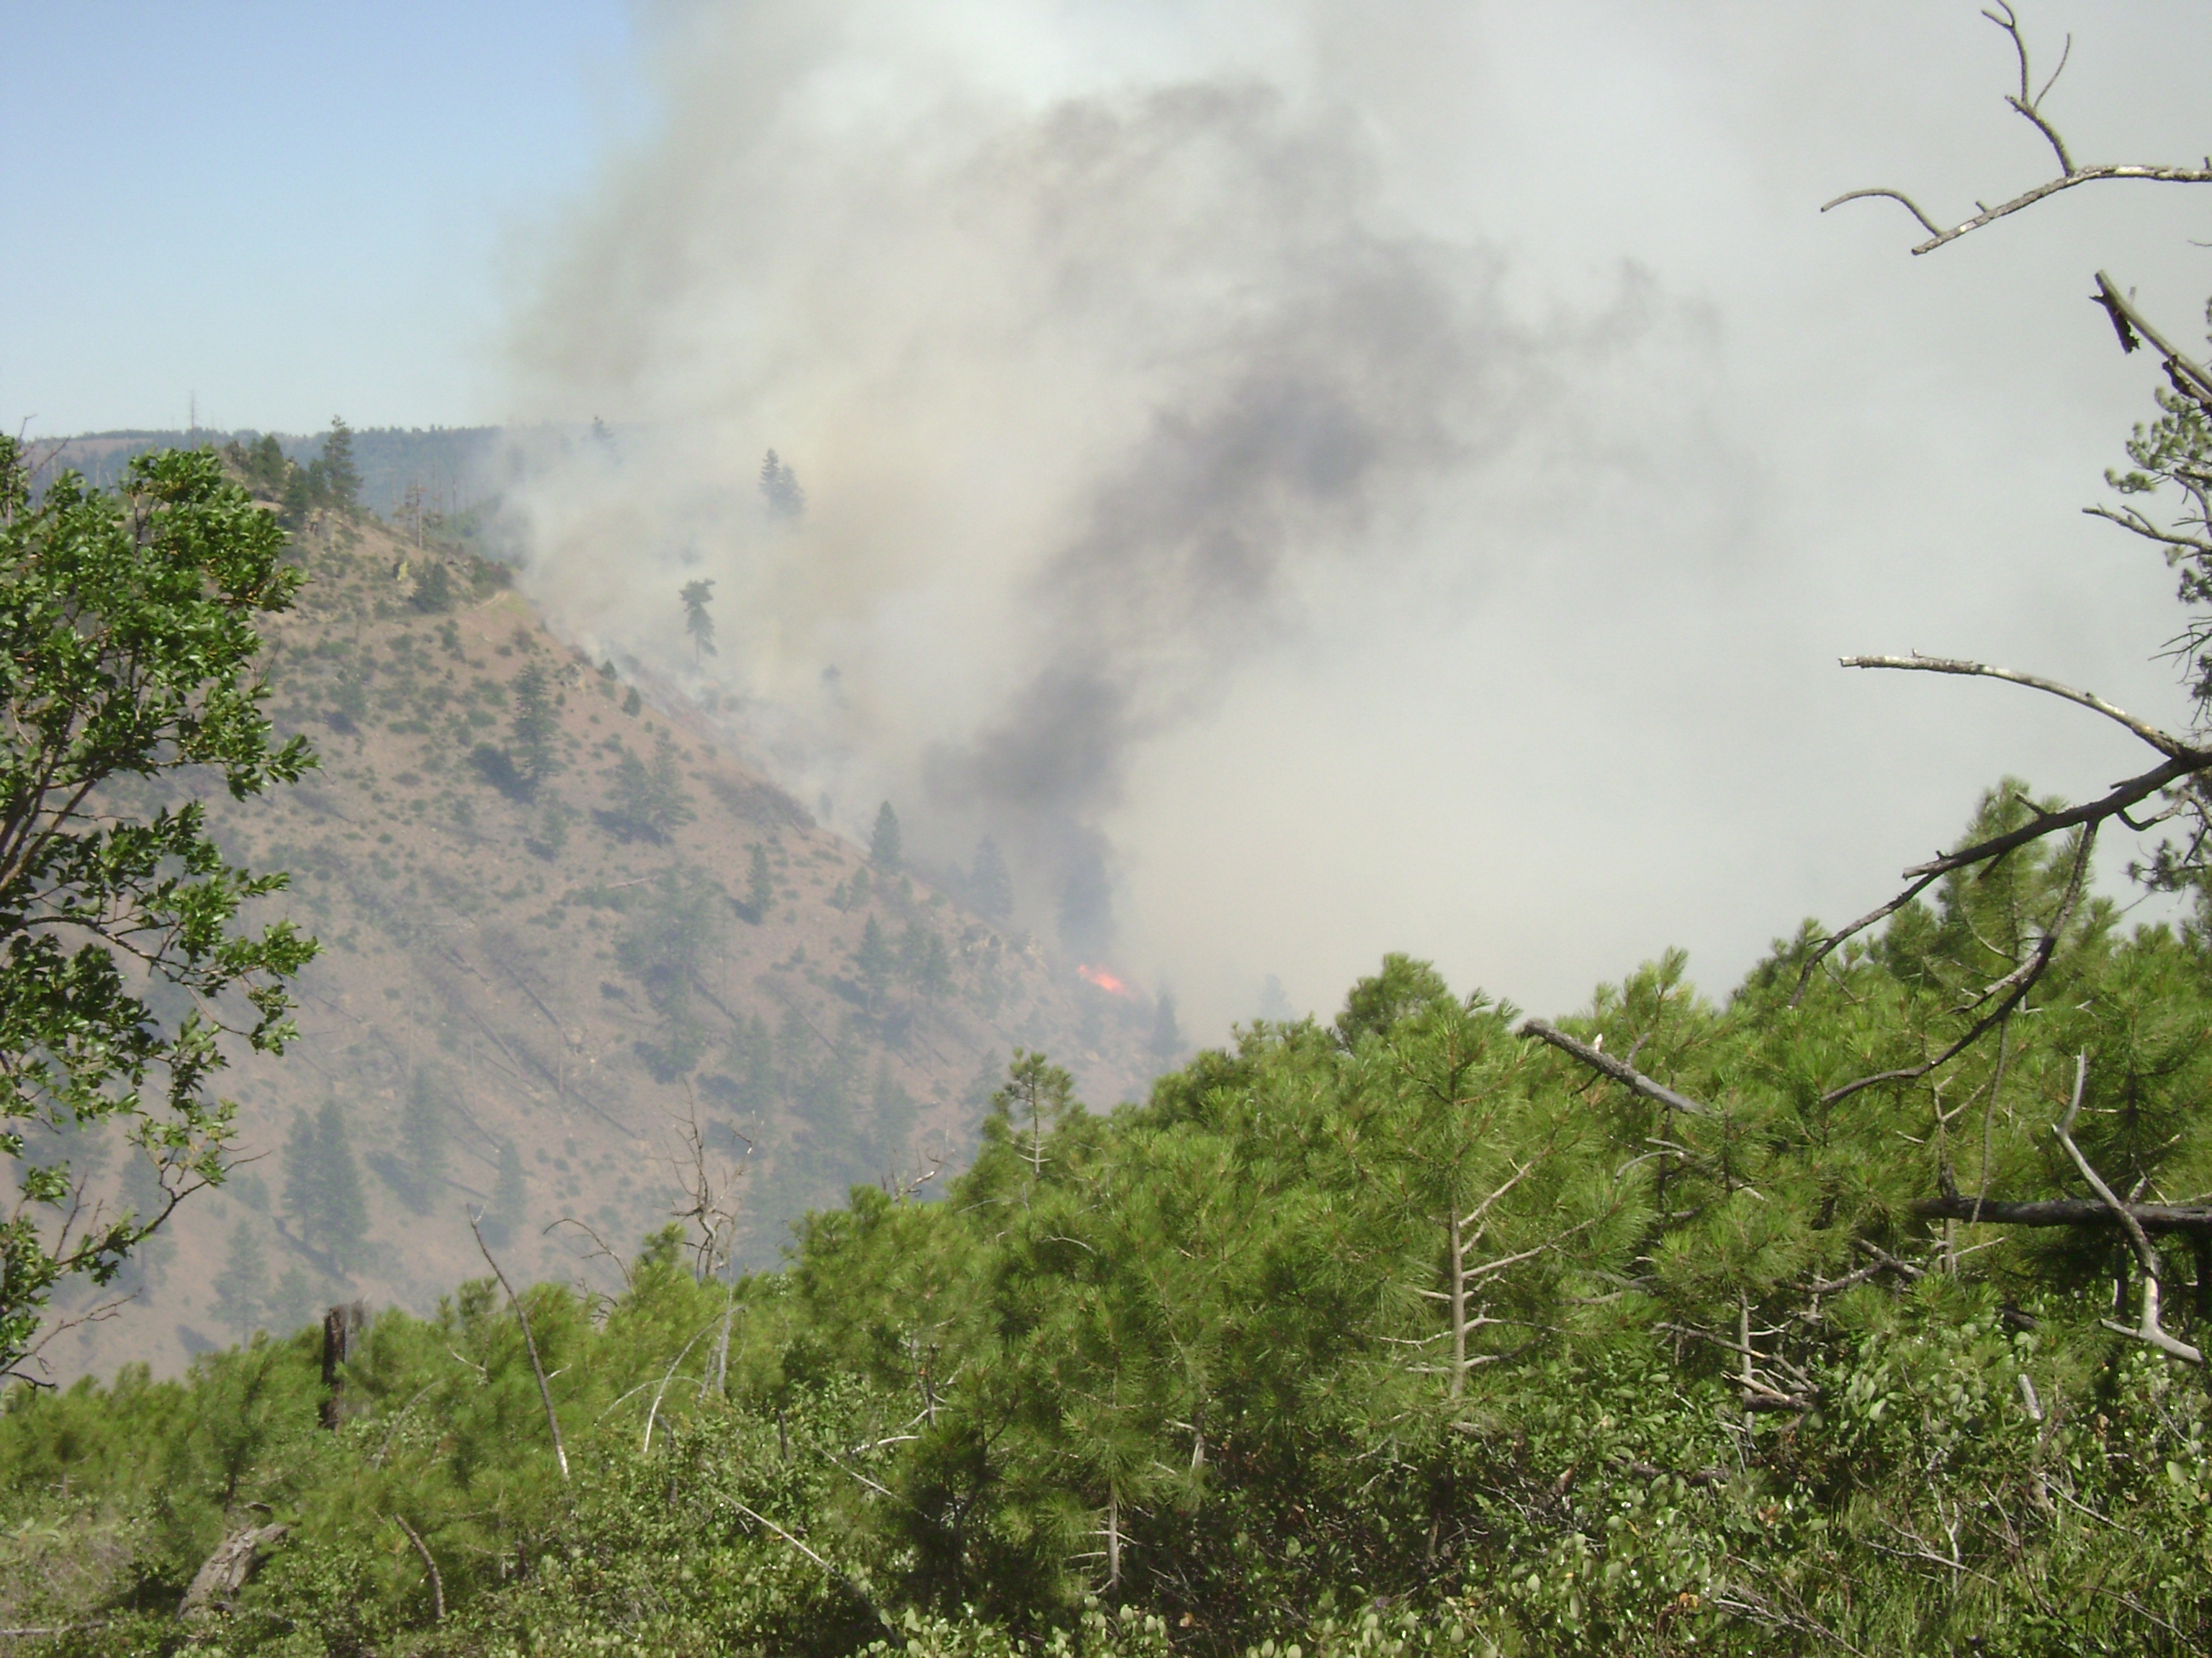
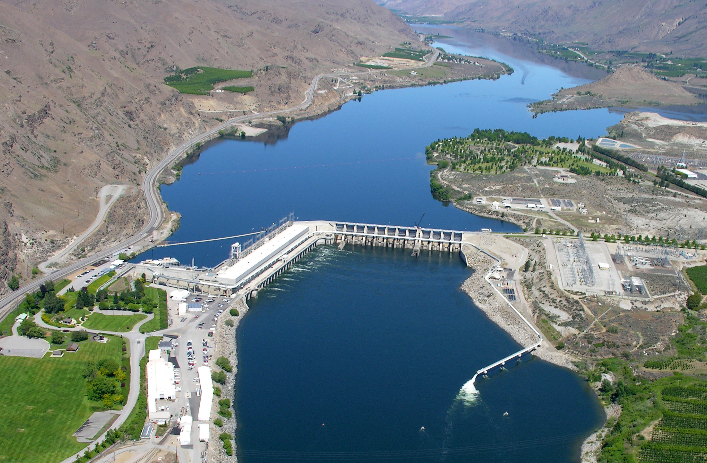
Document Outline
Resilience Strategy Outline
The strategy outlines the expected impacts of climate change in the following impact areas:
Wildfire
Snowpack & Streamflow
Flooding
Water Supply
Swakane Fire, 2010
Rocky Reach Dam

Slide 5
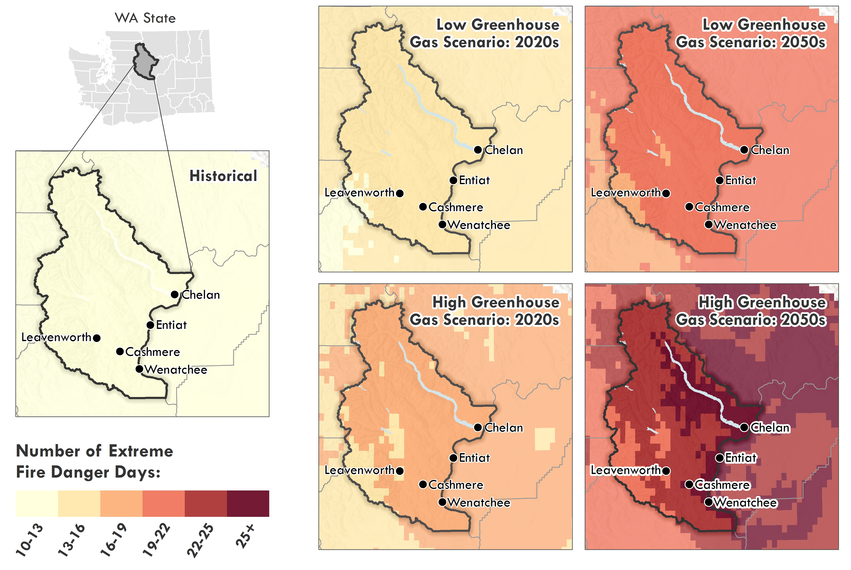
Resilience Strategy Outline
In each of the four main impact areas, it discusses:
Observed / Current Trends
Expected Changes
Impacts
Current Initiatives
Resilience Strategies
Example Map in Document: Extreme Fire Danger Days, Chelan County

Slide 6
Resilience Strategy Outline
Additional sections include:
Cross-Sector Strategies: resilience strategies that cut across subject areas, and address multiple hazards or expected climate conditions
Implementation Next Steps: a suggested framework for moving forward and advancing from strategies to action items

Slide 7
Example Strategies
Wildfire: Create fire adapted communities; protect critical facilities; coordinate and improve emergency preparedness systems
Snowpack and Streamflow: Collect local data to support climate resilience including weather stations/SNOTEL, seasonal wind patterns, etc.
Flooding: Evaluate and improve stormwater management and infrastructure for high-intensity rainfall events
Water Supply: Drought planning to increase water conservation; consider greywater systems and water re-use

Slide 8
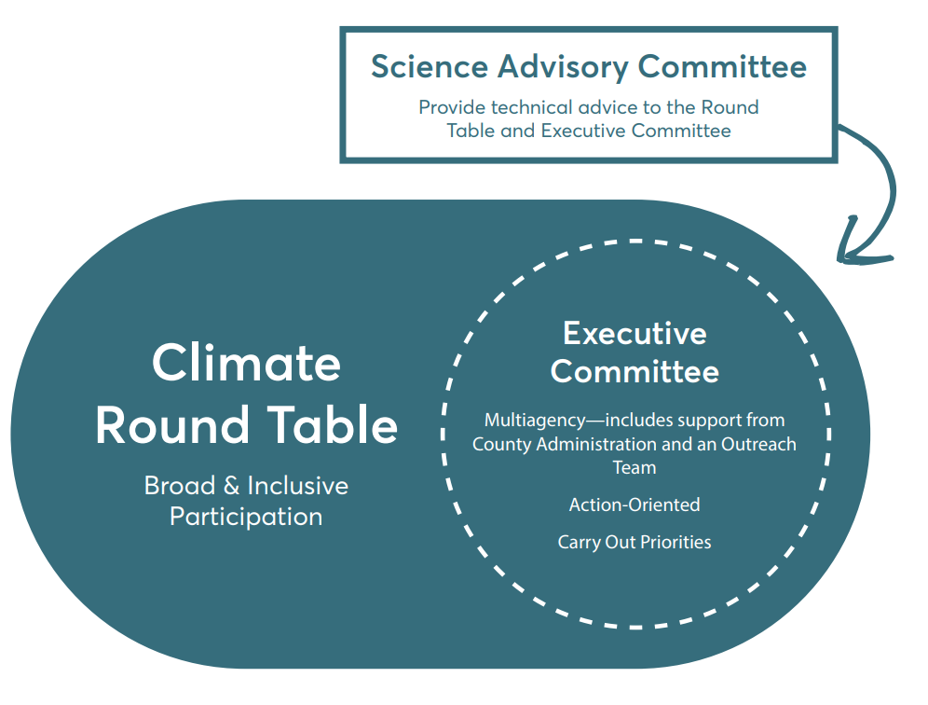
Background and Purpose
Implementation Next Steps
Turn strategies into actions, and establish Climate Round Table

Slide 9
Background and Purpose
Implementation Next Steps
Round Table will consist of three committees to define and implement on-the-ground actions:
Climate Round Table: will be open to anyone who has an interest in climate resilience
Executive Committee: will be a subset of the Round Table executing the group’s priorities
Science Advisory Committee: will provide technical advice to the Round Table and Executive Committee

Slide 10
Background and Purpose
Project Timeline
Multiple organizations and community members have been working on the process for nearly two years.
With a strategy in place, we can continue with coordinated action to create a climate resilient Chelan County
Initial community resilience conversations
Strategy kickoff
Draft strategy, survey, & workshop
Final Climate Resilience Strategy document
Implementation
2019
May 2020
Aug 2020
Oct 2020
Dec 2020 and beyond!
Opportunity to advance resilience projects across the county
Opportunity for 2021 funding
Convene Round Table in early 2021 to guide implementation

Slide 11
Thank you!

