Slide 1
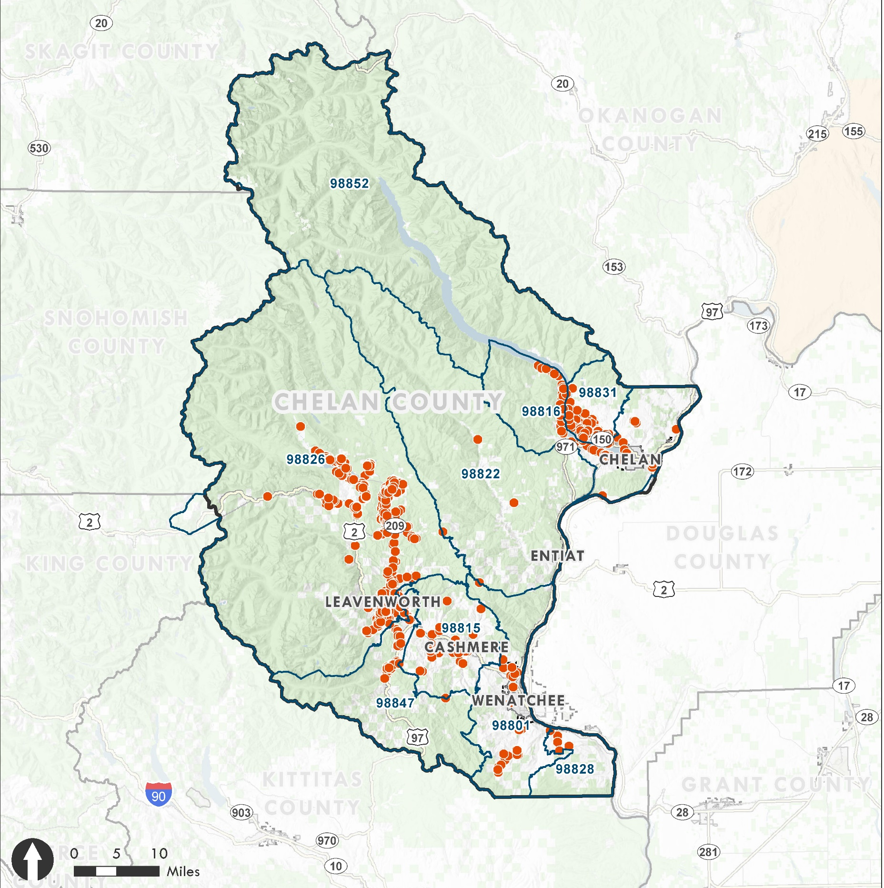

Short-Term Rentals
Chelan County
Board of County Commissioners
Study Session
August 4, 2020

Slide 2
Topics
Limits on Numbers & Types
Sunset Clauses, Transfer of Ownership & Best Practices
Permitting Options & Resources
Coordination with Cities
Distinction – Timeshares and STRs

Slide 3
Sunset Clauses, Transfer of Ownership
Intent:
Protect supply and affordability of housing
Protect neighborhood compatibility (e.g. proliferation or concentration)

Slide 4
Best Practices: Limits on Number and Type
Options | Considerations
Cap STR nights per year. Consider capping unhosted STRs rather than owner hosted STRs. Cap number of permissible STRs. Limit STRs to units used as Primary residences. Prevent Conversion of Housing Stock (prohibit STR in structure recently constructed). Consider limiting in ADUs where appropriate to preserve long-term rentals. | Existing Units and Nonconformities Ease of Enforcement
Sustainable Economies Law Center (March 2016)
MRSC (November 2017)

Slide 5
Example STR Regulations - Standards
Community | Vary Zone or Location Allowed | Vary Permit (Zone, Owner-Occupied, Large) | Operation Standards | Permit System (annual) | Inspections | Cap or Distance | Restrict Transfer of Ownership | Sunset Clause | Custom Non-conforming Rules
Chelan County, WA (Draft) | Yes | Yes | Yes | Yes | Yes | Yes | Yes | Yes (some) | Yes
Clallam County, WA | No | Yes | Yes |  |  | No | NA | No
Jefferson County, WA | Yes | Yes | Yes | No | Yes | Yes | No | No | No
Okanogan County, WA | Yes | Yes | Yes | Yes | Yes | No | No | No (removed) | No
Pacific County, WA | Yes | Yes | Yes | Yes | Yes | Yes (pending) | Yes | No | No
Pierce County, WA | No | No | Yes | Yes | Yes | No | No | No | No
San Juan County, WA | Yes | Yes | Yes | Yes | No | No | No | No | No
Spokane City, WA | Yes | Yes | Yes | Yes | Yes | No | No | No | Yes
Walla Walla City, WA | Yes | Yes | Yes | Yes | Yes | No | No | No | Yes
Bend, City, OR | Yes | Yes | Yes | Yes | Yes | Yes | Yes | No | Yes
Cannon Beach, City, OR | Yes | Yes | Yes | Yes | Yes | No (removed) | Yes | Yes | No
Newport, City, OR | Yes | Yes | Yes | Yes | Yes | Yes | Yes | No | Yes
Ventura County, CA | Yes | Yes | Yes | Yes | Yes | No | Yes | Yes | Yes
Shaded 4% or more of STRs

Slide 6
Options for Chelan County
Set Cap Countywide on number of permits or by Area Impacted
Ease of Implementation
Set specific numeric cap for first 1 or 2 years in code for Type 2 or 3 STRs to allow time for permit resources to be addressed
Simplify areas restricted from new Type 2 or Type 3 STRs
Confirm % share of STRs desired to address affordability and concentration
Limit in Zip Codes > X%*
Limit in UGAs
Determine if other areas should be limited
e.g. if 5% is applied countywide through all unincorporated areas this would also limit new STRs in low concentration areas
*5% recommended in Oregon study and by PC

Slide 7
Sunset Clauses & Transfers
Sunset Clauses
Applied in Oregon and California examples, and other states
Not applied in reviewed Washington counties and cities
Was in Okanogan County Code and then removed
Could further limit when/where used
Transfer limitations used in some high concentration communities
Restrict transfers/sales – e.g. no transfers, time-limited transfer, one transfer
Additional Option:
Stricter non-conformity rules
For example, if STR not in use for 6 months rather than 12 months, as well as if not maintaining consistency with standards and annual permit

Slide 8
Permitting Options & Resources
Existing STRs
Address Community Dev. staff and Hearing Examiner resources
Permitted STRs:
Lengthen time for provisional approvals
CUPs
Reduce CUPs
Permit Type 1 STRs in resource zones since owner-occupied
Permit Type 3 STRs on RR20 properties (large lot)
Allow for administrative CUPs – amend code authority (e.g. 14.04.020 Director and 14.04.050 Hearing examiner)

Slide 9
Coordination with Cities
Interlocal provides for County application of City regulations
STR Code proposes that STRs be allowed according to city allowances where County has adopted the standards but following County review procedures

Slide 10
Distinction – Timeshares and STRs
Timeshare
STRs
Definition: Buy a period of time at a unit in a resort – fixed or variable time. Could exchange your time for another.
Site is meant for resort use.
Resorts are managed professionally.
On-site amenities and activities.
Definition: Rental of a home/room for less than 30 days.
Proposed code does not count STRs in Master Planned Resorts or PUDs in the permit cap.
If timeshare owner advertises as STR and must pay state taxes, it should be subject to annual permit.
Some timeshares in Chelan city limits acted like STRs and were treated as such. They paid state taxes. The City regulated them.

Slide 11
Appendix: Planning Commission Proposal

Slide 12
BOCC Vision
Those standards may include, but are not limited to:
parking,
garbage,
noise,
trespassing,
privacy,
septic capacity,
fire risk,
consumer safety,
signs,
hot tubs, pools and spas,
occupancy limits by zone and neighborhood,
density by zone and neighborhood,
commercial and liability insurance,
and the availability of STR owner/operators to respond to a complaint within a short-time frame.
The Board of Commissioners intends to adopt code that addresses the rapid proliferation of short-term rentals in Chelan County.
The BOCC wishes to protect the character of residential communities across the county, while allowing for property-owner income from short-term rentals. The BOCC recognizes that STRs are an important part of our economy. However, while many owner/operators manage their properties responsibly, many clearly do not.
Chelan County needs the tools to ensure that all STR owner/operators meet a minimum set of standards.
To ensure that these standards are met, the BOCC wishes to impose an annual registration fee for STRs to finance the following: fire marshal inspection, health district inspection, permit processing by Community Development Department, and code compliance cost recovery. Enforcement should be sufficient to allow for closure of short-term rentals that repeatedly violate code.
Nothing in the code will be inconsistent with RCW 64.37 or with the Manson and Peshastin Urban Growth Areas.
The BOCC wishes to have this process completed by August 2020.

Slide 13
Code Outline
Use Allowance Amendments
Chapter 11.04 District Use Chart
Chapter 11.22 Peshastin Urban Growth Area
Chapter 11.23 Manson Urban Growth Area
Supplementary Provisions And Accessory Uses
Chapter 11.88
11.88.280 Short-Term Rental Regulations (new)
Conditional Use Permits
11.93.450 (cross ref)
Fees
3.24.010 Fee Schedule
Definitions
14.98
Person (amended)
Bedroom (new)
Short-Term Rental (new)
Short-Term Rental Operator (new)
Short-Term Rental Owner (new)
Enforcement
Title 16
16.20. Short-Term Rental Enforcement and Violations (new)

Slide 14
Proposed Short-Term Rental Regulation Process
Permitted or CUP in Zone Use Tables
+ Existing STRs meeting criteria
Tier 1: Owner Occupied
+ Any Tier in PUD and MPR Zones, Permitted with Criteria
1% Cap Does Not Apply
Allowed in any location
Tier 2: Non-Owner Occupied, Permitted with Criteria
1% Cap Countywide + Subareas
Must meet standards
Must obtain land use permit
Restrict in UGAs, Zip Codes with > 5% STR
Must meet standards
Must obtain land use permit
5-Year Sunset on Lots less than 2.5 acres in RR2.5, RW, RV
Tier 3: Larger Occupancy greater than 12 total persons
1% Cap Countywide + Subareas
Restrict in UGAs, Zip Codes with > 5% STR
5-Year Sunset on Lots less than 2.5 acres in RR2.5, RW, RV
Must meet standards
Must obtain land use permit (CUP)

Slide 15
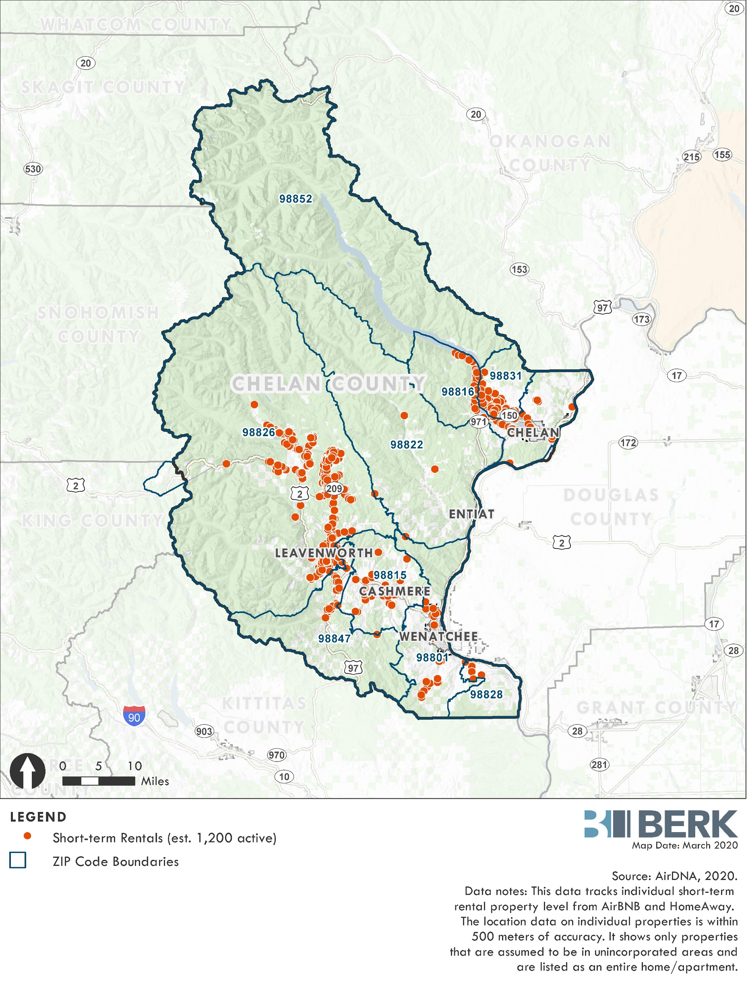
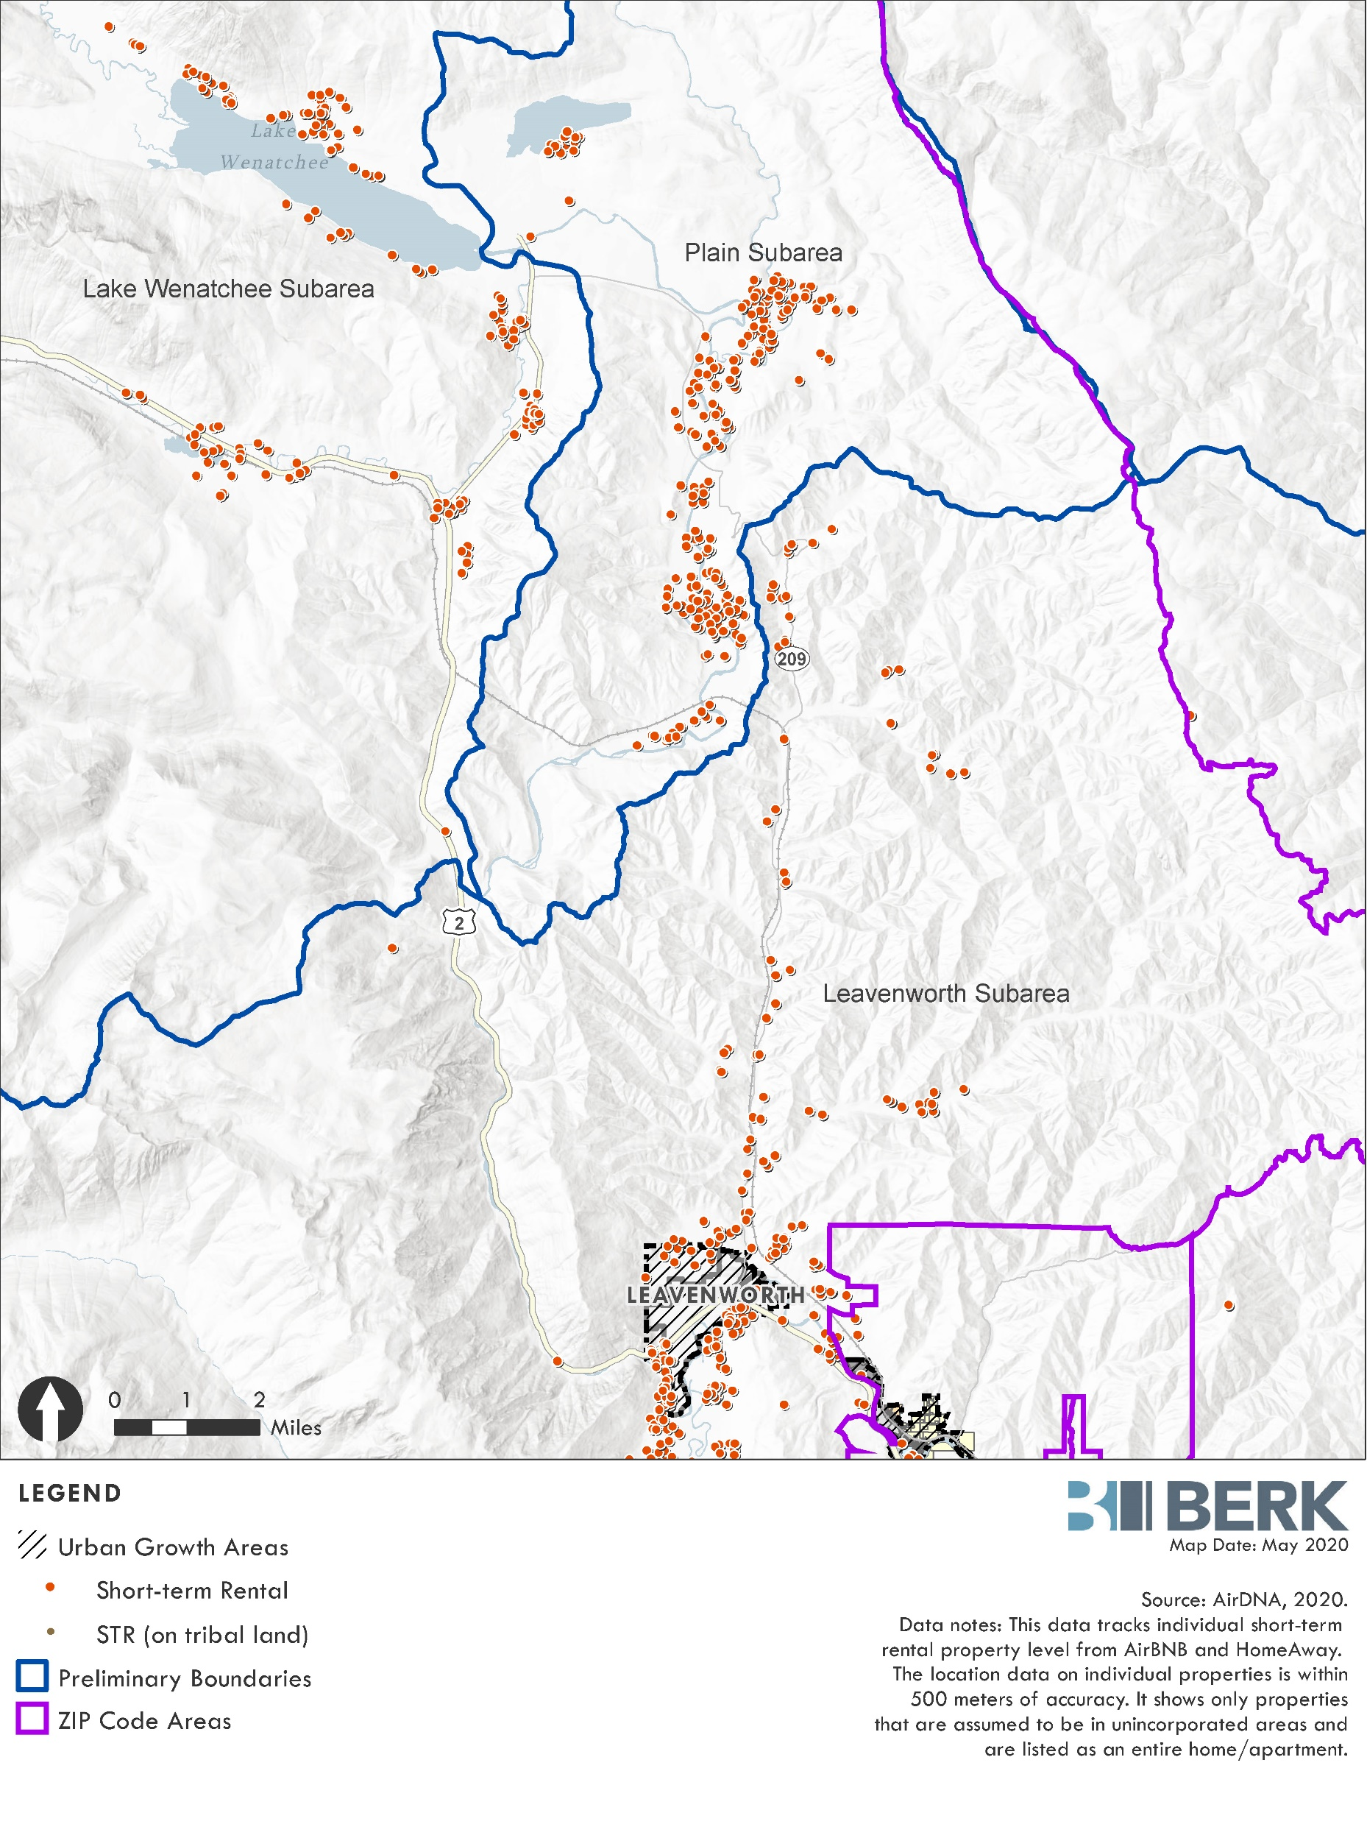
Boundary in Leavenworth-Lake Wenatchee Zip Code

Slide 16
Existing Units
(iii) Existing Short-Term Rentals: [All must show following]
(a) That similar uses were allowed in the subject zones at the time the short-term rental was established, including but not limited to: bed and breakfast, guest inn, boarding house, lodging facility, hotel/motel, or other transient accommodation; and
(b) That a location was used for short-term rental purposes during January 1, 2019 to XXX [effective date]. The Director may permit homes with approved building permits after January 2019, constructed within six months of the effective date of this ordinance to be considered as an existing short-term rental; and
(c) That all applicable state and local taxes were fully and timely paid for all short-term rental use that occurred prior to XXX [effective date], which at a minimum includes sales tax and hotel/motel taxes; and
(d) That the short-term rental meets all requirements of subsection (3); and
(e) That the short-term rental operator has obtained the required land use permits in subsection (4); and
(f) If located inside of the Manson Urban Growth Area, documentary evidence that the short-term rental was properly registered as a vacation rental with Chelan County per 11.23.040 as of XXX [effective date].
(iv) Nonconforming Short-Term Rental Units in Restricted Zones:
Where a zone does not allow short-term rental units as of XXX [effective date] according to CCC Sections 11.04.020, 11.22.030, or 11.23.030,
only those short-term rentals that exist as of XXX [effective date] and
are compliant with criteria in subsection (iii) above, will be allowed as nonconforming uses.
Such uses may not be significantly changed, altered, extended, or enlarged and must cease after two years from XXX [effective date].
After expiration or revocation of the permit authorizing a legal nonconforming short-term rental, no operator shall operate a short-term rental.

Slide 17
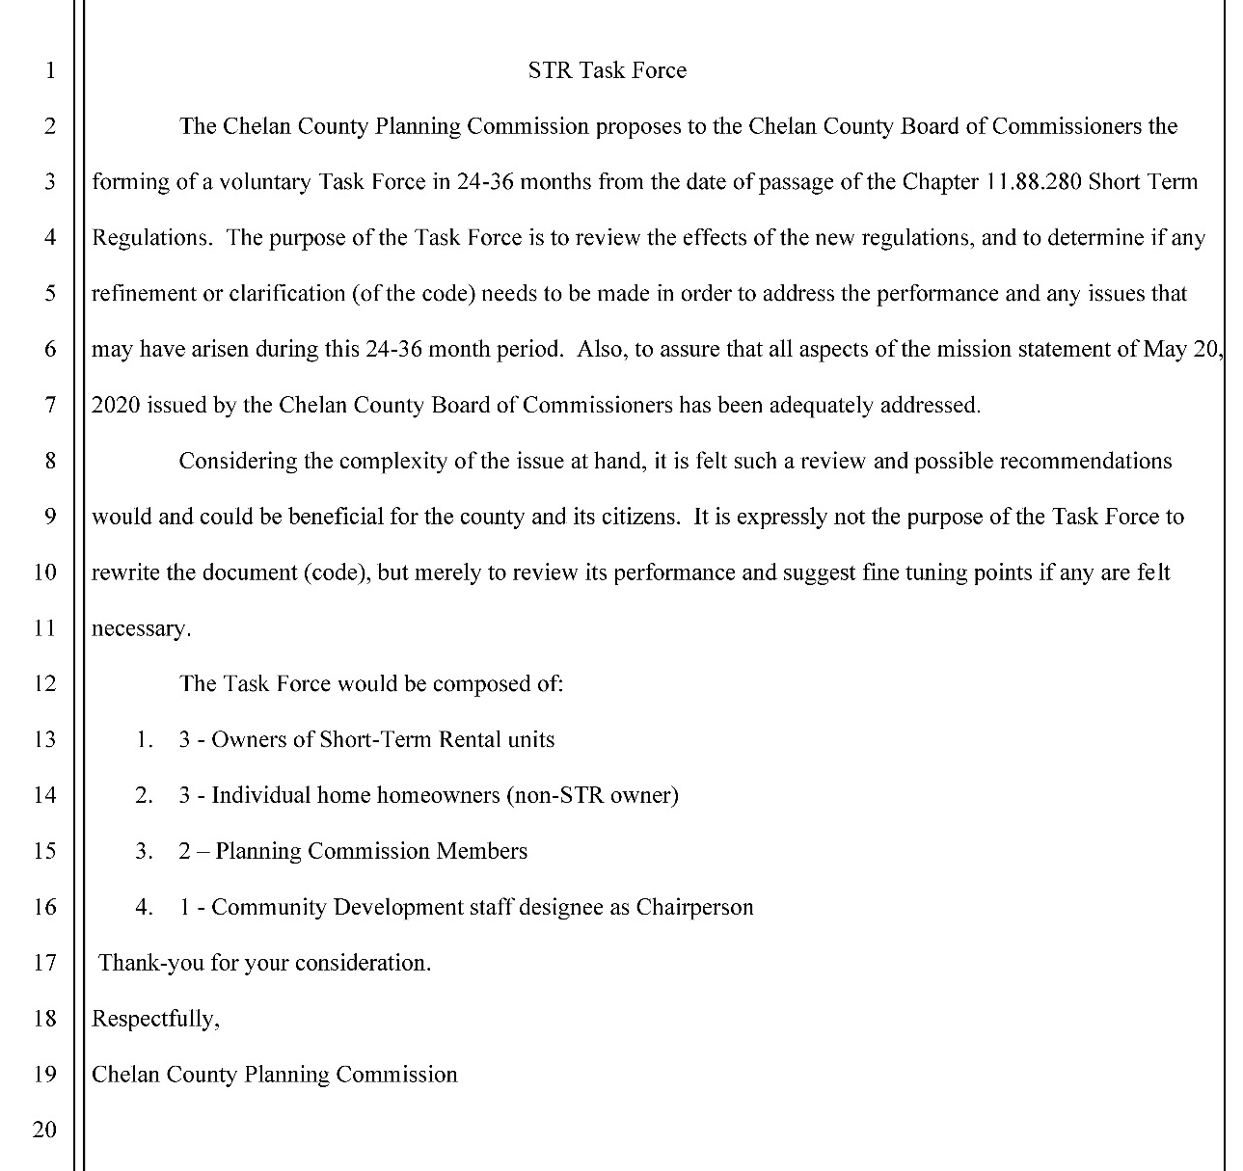
Task Force
Voluntary
Review effects of regulations and determine refinements or clarifications
24-36 months after passage of regulations
Members:
3 STR owners
3 Homeowners
2 Planning Commissioners
1 CD Staff as Chair

Slide 18
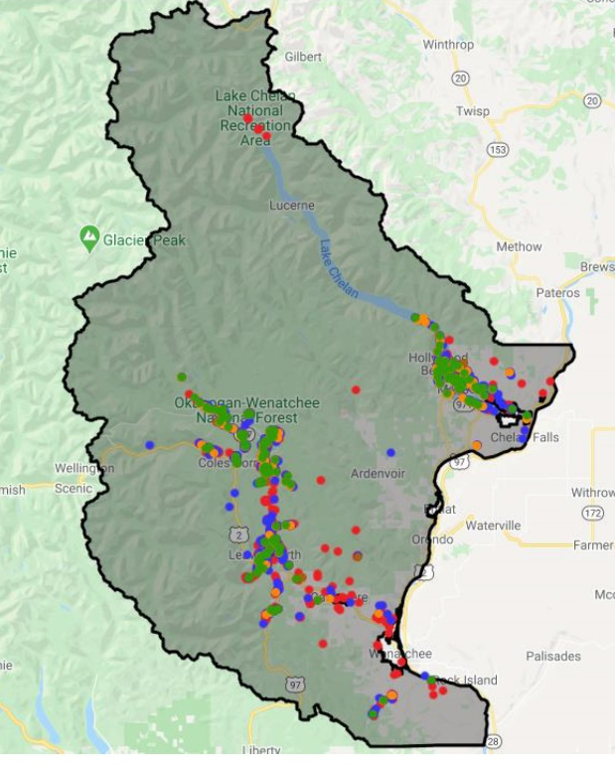
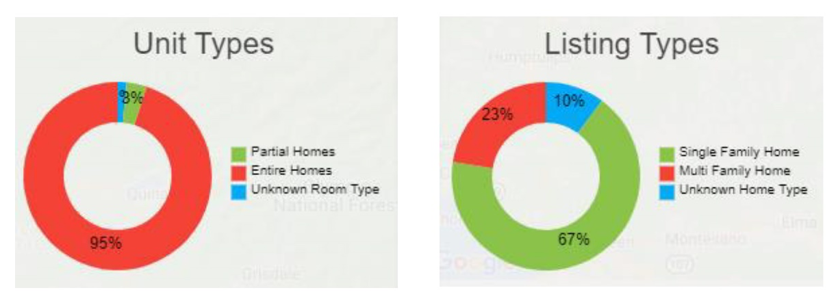
Background Information - STRs
1,535 unique rental units as of March 2020.
Most short-term rentals are offered as entire homes, and most are single-family in format.
Host Compliance, March 2020

Slide 19
Data Available for STR Evaluation
AirDNA
Addresses AirBNB & Home Away
Over 1,300 units as of January 2020
Majority of Units in Host Compliance Data
Reviewed growth and location information

Slide 20
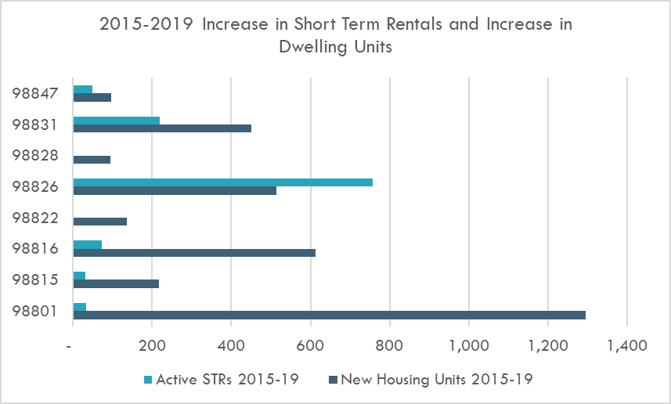
Background: Share of STRs
Unincorporated Chelan County Entire Home Short-Term Rentals as Share of Total Housing Units

