Slide 1
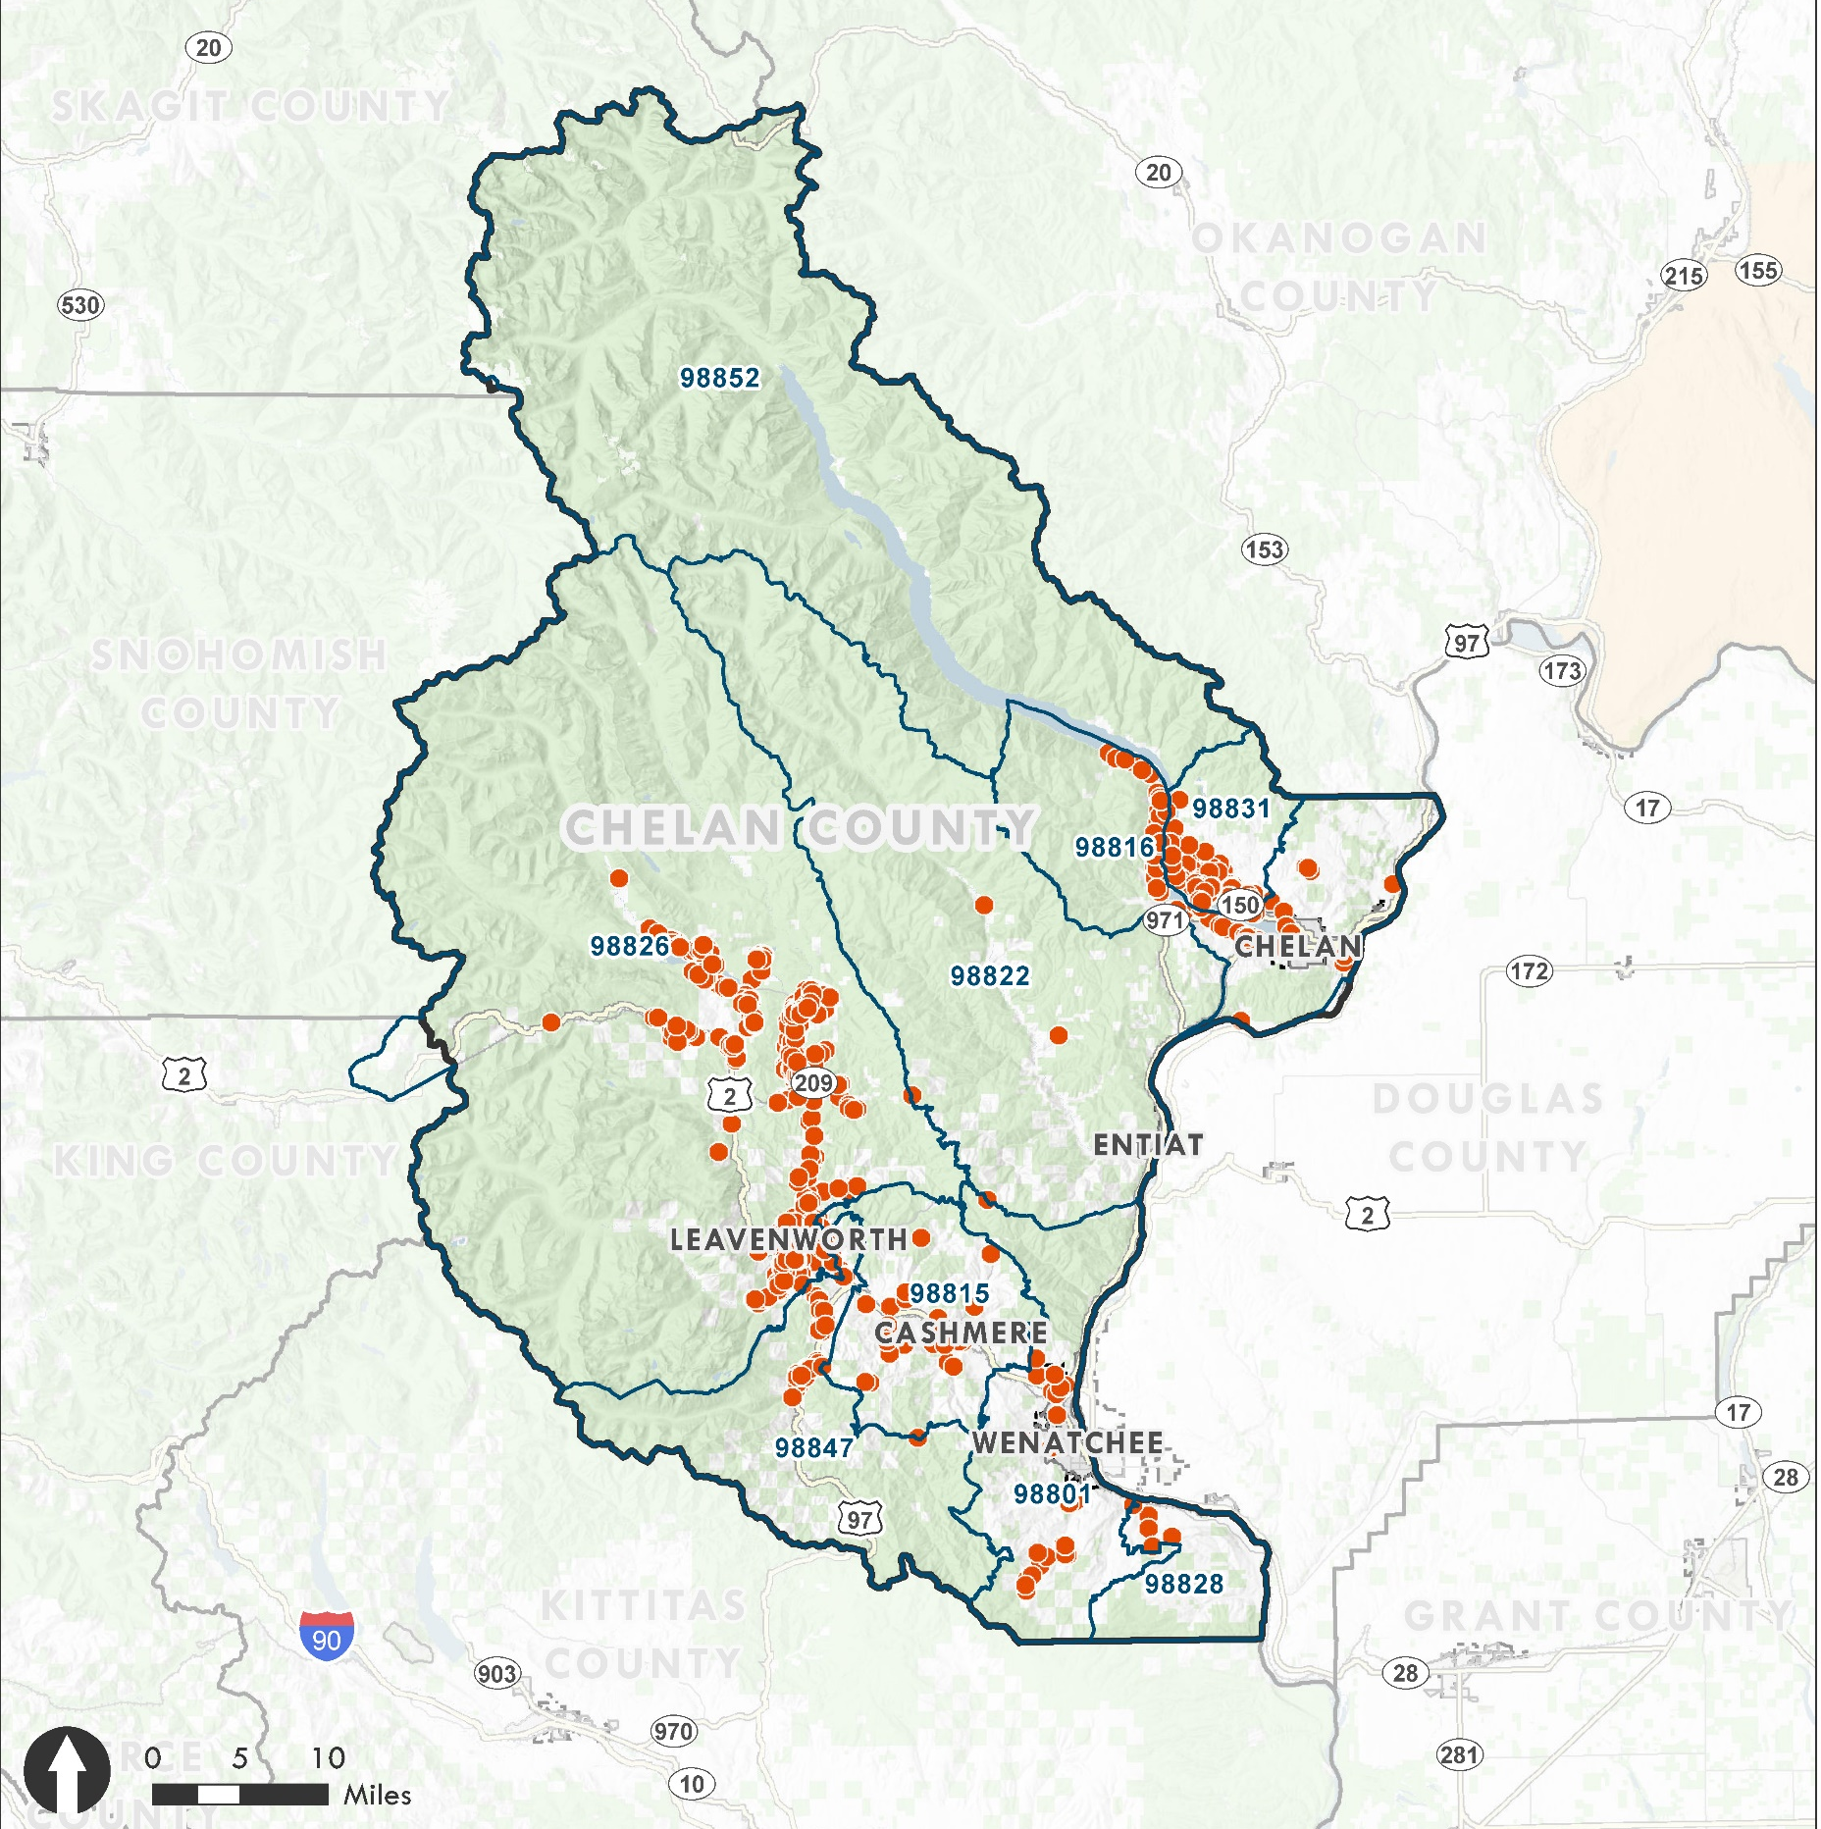

Short-Term Rentals
Chelan County
Planning Commission
Hearing
June 17, 2020

Slide 2
Presentation Topics
Process & Schedule
Background
Guiding Vision
Summary of Hearing Draft Code
Clarifying Questions / Conduct Hearing

Slide 3
Process
Step 1.
Target: March-April 2020
Develop Situation Assessment
Develop Code Options
Step 2.
Target: April-June 2020
Planning Commission (PC)
Study Session
PC Public Hearing & Deliberation
Step 3.
Target: July-Aug 2020
Board of County Commissioner (BOCC) Work Session
BOCC Public Hearing & Deliberation & Decision

Slide 4
Schedule
Planning Commission
  Study Sessions: April 22, May 13, May 27, June 3
  Hearing: June 17
  Deliberation: June 24
BOCC
  Work Session: July 7, 6:30 pm
  Hearing: July 21, 5:30 pm
  Deliberation: August 4, 5:30 pm

Slide 5
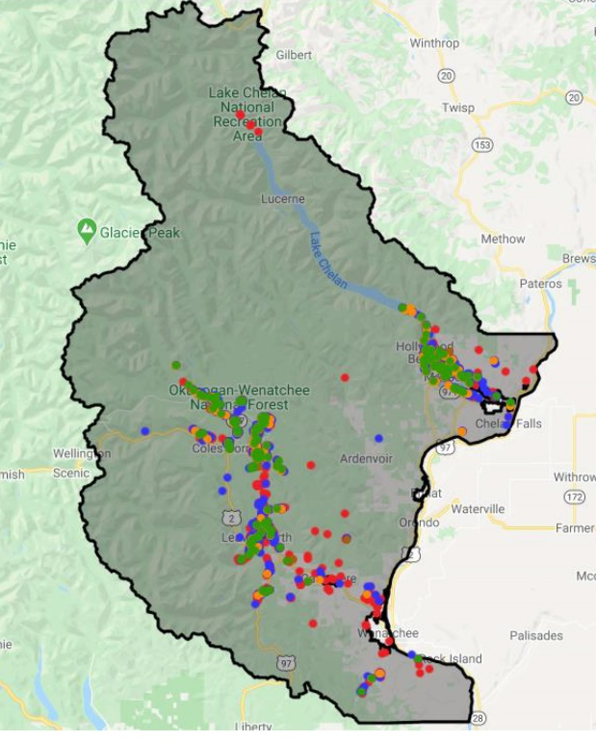
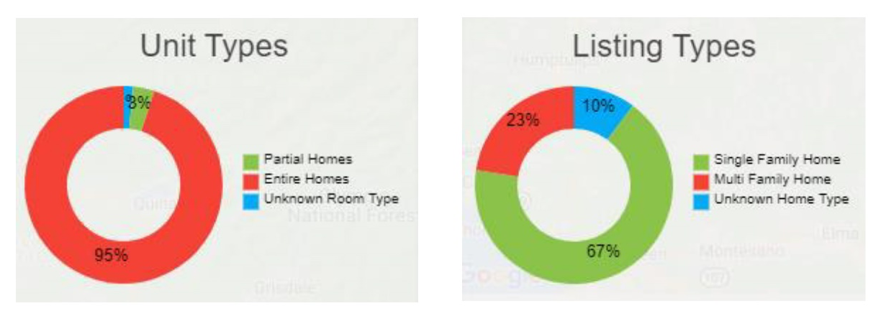
Background Information - STRs
1,535 unique rental units as of March 2020.
Most short-term rentals are offered as entire homes, and most are single-family in format.
Host Compliance, March 2020

Slide 6
Data Available for STR Evaluation
AirDNA
  Addresses AirBNB & Home Away
  Over 1,300 units as of January 2020
  Majority of Units in Host Compliance Data
  Reviewed growth and location information

Slide 7
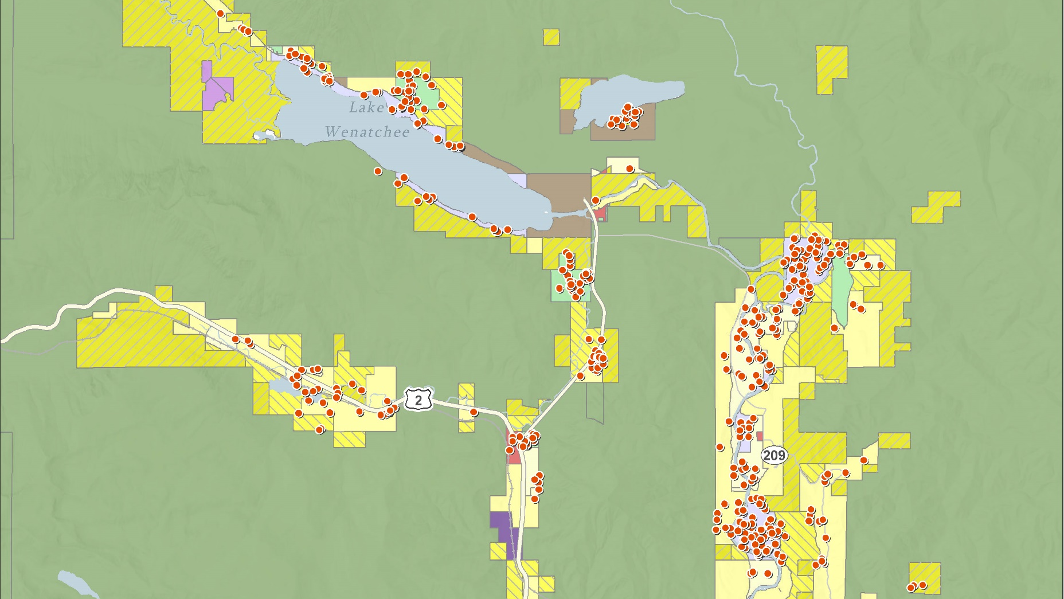
Lake Wenatchee Area
Geographic location is accurate for most properties with some locations within 500 meters for privacy.

Slide 8
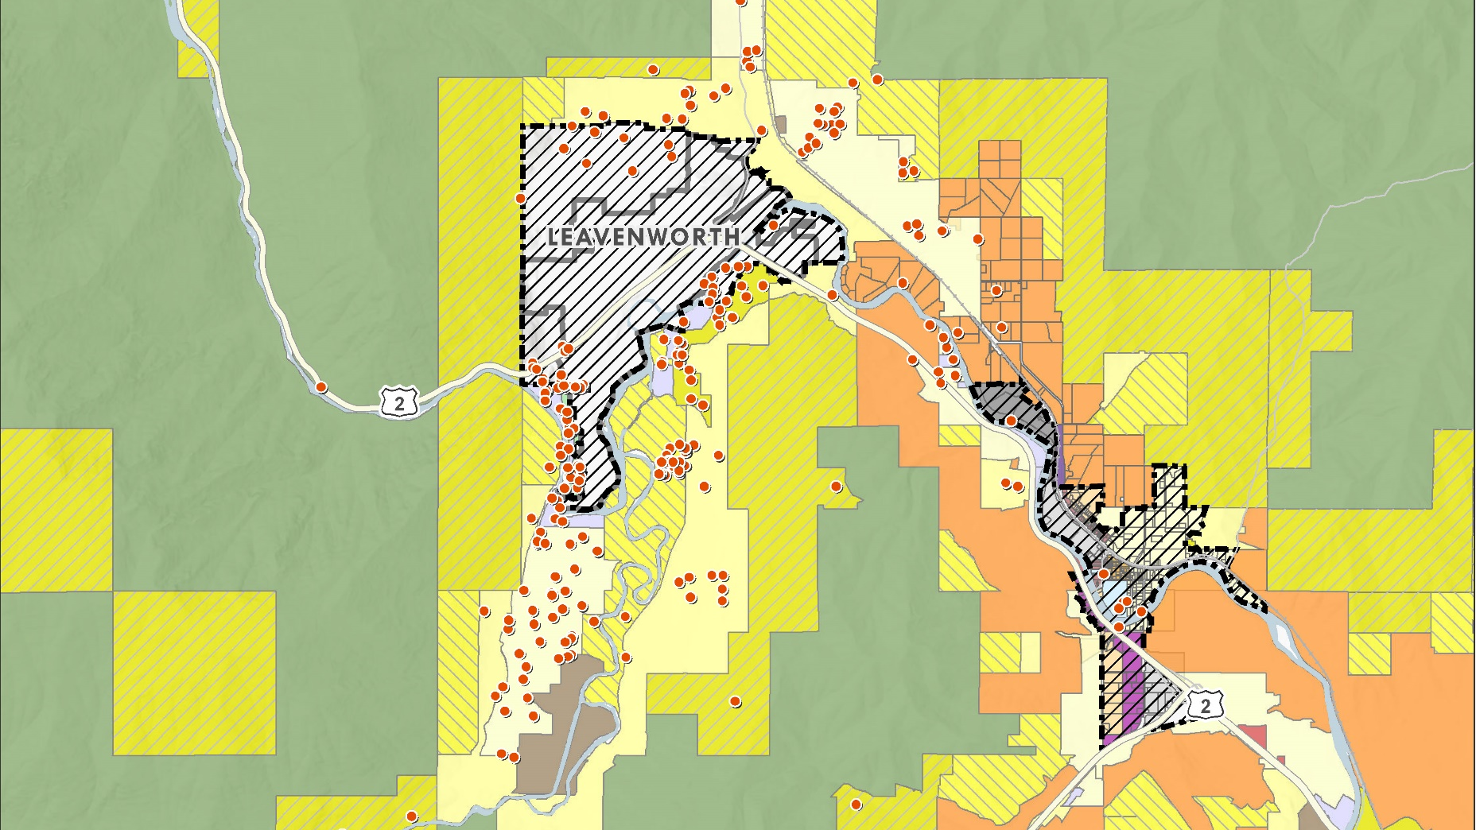
Leavenworth & Peshastin
Geographic location is accurate for most properties with some locations within 500 meters for privacy.

Slide 9
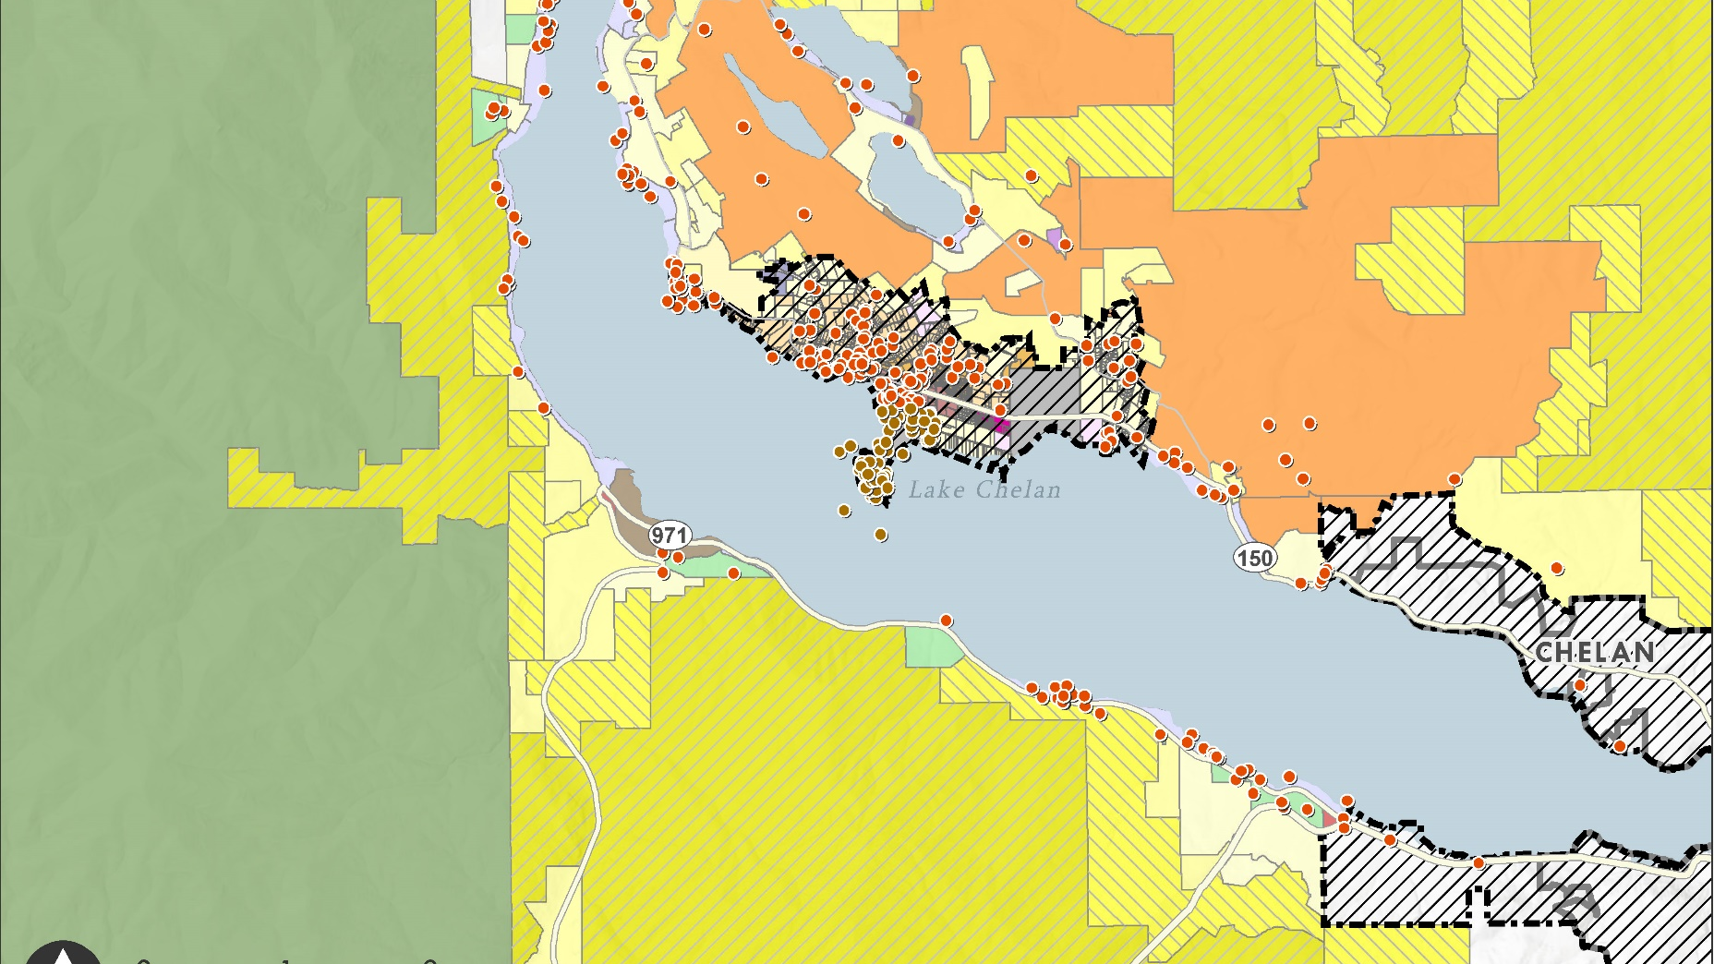
Manson/ Chelan Area
Geographic location is accurate for most properties with some locations within 500 meters for privacy.

Slide 10
Background: Growth in STRs
Unincorporated Chelan County Listings December 2014-19: AirBnB & Home Away Monthly Data
Zip Code | Zip Code Place | 2014 | 2015 | 2016 | 2017 | 2018 | 2019
98815 | Cashmere |  | 4 | 11 | 25 | 30 | 35
98816 | Chelan | 1 | 3 | 14 | 64 | 60 | 75
98822 | Entiat |  | 3 | 4 | 4 | 2 | 2
98826 | Leavenworth | 59 | 110 | 205 | 611 | 816 | 868
98828 | Malaga | 1 | 2 | 2 | 4 | 4 | 4
98831 | Manson* | 6 | 9 | 56 | 212 | 215 | 229
98847 | Peshastin | 4 | 8 | 16 | 41 | 47 | 56
98801 | Wenatchee | 5 | 6 | 14 | 25 | 32 | 39
Grand Total |  | 76 | 145 | 322 | 986 | 1,206 | 1,308

Slide 11
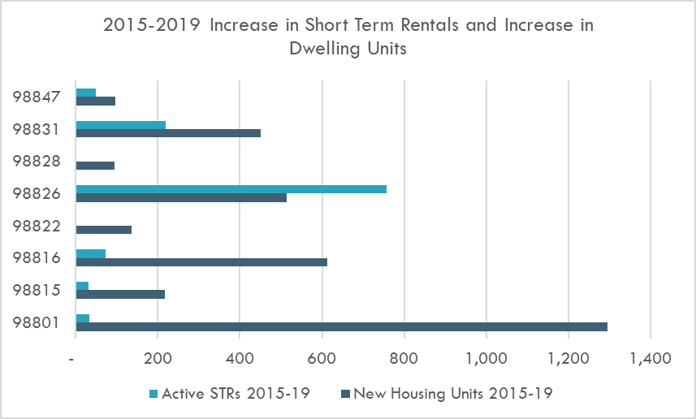
Background: Share of STRs
Unincorporated Chelan County Entire Home Short-Term Rentals as Share of Total Housing Units

Slide 12
Most STRs are Rented as Entire Homes
January 2020: AirBnB and HomeAway Listings Property Data
Zip Code | Private Room | Entire Home/Apartment
Cashmere | 11 | 28
Chelan | 3 | 97
Entiat |  | 4
Leavenworth | 55 | 749
Manson* | 7 | 5
Malaga |  | 281
Peshastin | 3 | 53
Wenatchee | 13 | 30
Grand Total | 92 | 1,247
*Includes housing on Wapato - about 83 in Manson

Slide 13
BOCC Vision
Those standards may include, but are not limited to:
parking,
garbage,
noise,
trespassing,
privacy,
septic capacity,
fire risk,
consumer safety,
signs,
hot tubs, pools and spas,
occupancy limits by zone and neighborhood,
density by zone and neighborhood,
commercial and liability insurance,
and the availability of STR owner/operators to respond to a complaint within a short-time frame.
The Board of Commissioners intends to adopt code that addresses the rapid proliferation of short-term rentals in Chelan County.
The BOCC wishes to protect the character of residential communities across the county, while allowing for property-owner income from short-term rentals. The BOCC recognizes that STRs are an important part of our economy. However, while many owner/operators manage their properties responsibly, many clearly do not.
Chelan County needs the tools to ensure that all STR owner/operators meet a minimum set of standards.
To ensure that these standards are met, the BOCC wishes to impose an annual registration fee for STRs to finance the following: fire marshal inspection, health district inspection, permit processing by Community Development Department, and code compliance cost recovery. Enforcement should be sufficient to allow for closure of short-term rentals that repeatedly violate code.
Nothing in the code will be inconsistent with RCW 64.37 or with the Manson and Peshastin Urban Growth Areas.
The BOCC wishes to have this process completed by August 2020.

Slide 14
Key Elements of Draft Code
# | Best Practice | Approach in Draft Code on Short-Term Rentals
1 | Establish protections for the supply and affordability of housing | Allow a small increase annually in short-term rentals, e.g. 1% countywide. In areas with a high concentration (greater than 5%), allow existing short-term rentals compliant with rules, but restrict new ones. Owner-occupied short-term rentals (Tier 1) are preferred over non-owner-occupied short-term rentals (Tier 2) as it retains housing for long-term residents and addresses neighborhood quality.
2 | Preserve neighborhood quality | Nighttime and daytime occupancy Larger-occupancy STRs are allowed with a conditional use permit Address parking, solid waste management, etc.
3 | Create protections for the wellbeing of guests | Provide for property management plan, health and safety, insurance, etc.
4 | Establish oversight and complaint procedures for wellbeing of neighbors | Provide process for code compliance integrated with County code and state laws.
5 | Preserve public tax revenues and level the playing field | Require short-term rentals owners/operators to comply with local and state tax requirements.
6 | Regular permitting & record keeping | Provide process for initial permit and annual renewal.
7 | Establish clear definitions | Consider state definitions and adapt for local needs.

Slide 15
Proposed Short-Term Rental Regulation Process
Permitted or CUP in Zone Use Table
+ Existing STRs meeting criteria
Tier 1: Owner Occupied
+ Any Tier in RRR PUD, MPR Zones
1% Cap Does Not Apply
Allowed in any location
Tier 2: Non-Owner Occupied and
Tier 3: Larger Occupancy
1% Cap Countywide + Subareas
Must meet standards
Must obtain land use permit
Restrict in Zip Codes with > 5%, Manson UGA R zones,
City UGAs
Must meet standards
Must obtain land use permit

Slide 16
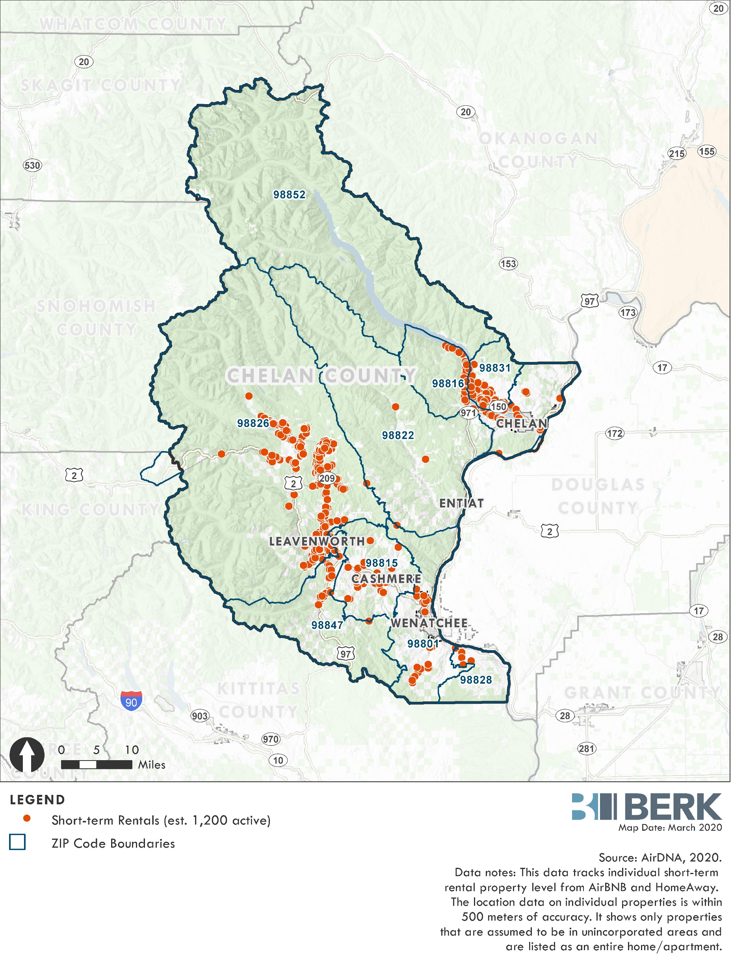
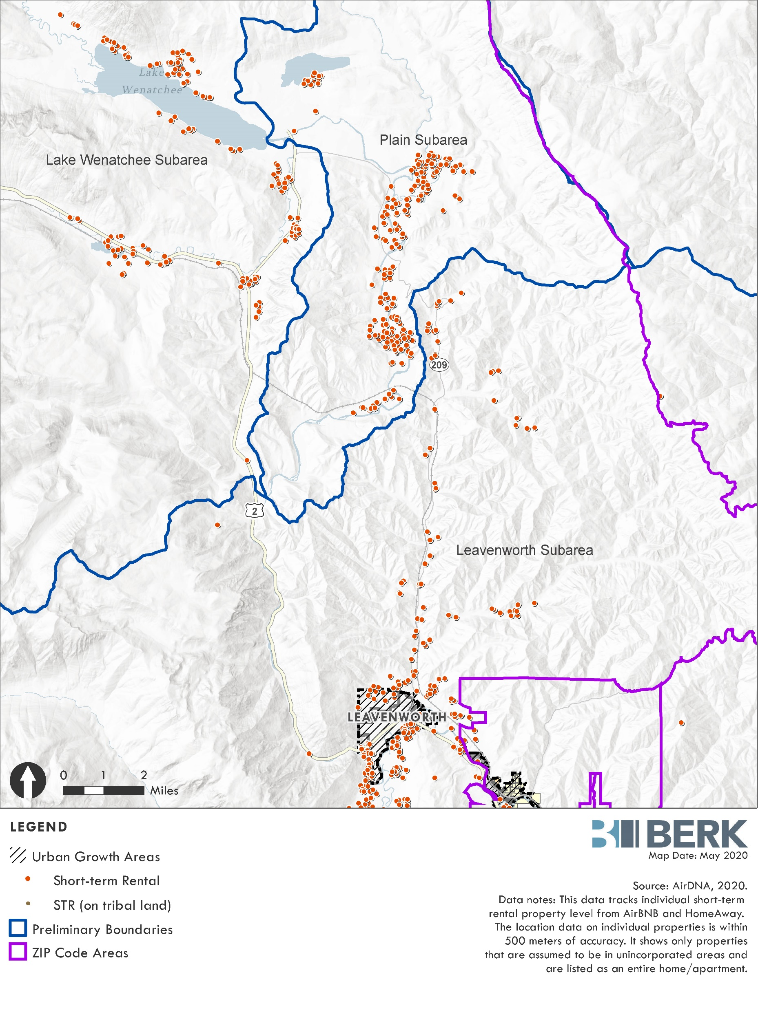
Boundary in Leavenworth-Lake Wenatchee Zip Code

Slide 17
Existing Units
(iii) Existing Short-Term Rentals: [All must show following]
(a) That similar uses were allowed in the subject zones at the time the short-term rental was established, including but not limited to: bed and breakfast, guest inn, boarding house, lodging facility, hotel/motel, or other transient accommodation; and
(b) That a location was used for short-term rental purposes during January 1, 2019 to XXX [effective date]. The Director may permit homes with approved building permits after January 2019, constructed within six months of the effective date of this ordinance to be considered as an existing short-term rental; and
(c) That all applicable state and local taxes were fully and timely paid for all short-term rental use that occurred prior to XXX [effective date], which at a minimum includes sales tax and hotel/motel taxes; and
(d) That the short-term rental meets all requirements of subsection (3); and
(e) That the short-term rental operator has obtained the required land use permits in subsection (4); and
(f) If located inside of the Manson Urban Growth Area, documentary evidence that the short-term rental was properly registered as a vacation rental with Chelan County per 11.23.040 as of XXX [effective date].
(iv) Nonconforming Short-Term Rental Units in Restricted Zones:
Where a zone does not allow short-term rental units as of XXX [effective date] according to CCC Sections 11.04.020, 11.22.030, or 11.23.030,
only those short-term rentals that exist as of XXX [effective date] and
are compliant with criteria in subsection (iii) above, will be allowed as nonconforming uses.
Such uses may not be significantly changed, altered, extended, or enlarged and must cease after two years from XXX [effective date].
After expiration or revocation of the permit authorizing a legal nonconforming short-term rental, no operator shall operate a short-term rental.

Slide 18
Hearing
Planning Commission Clarifying Questions
Open Hearing & Take Testimony

