Slide 1
Proposals

Slide 2
Business Incubator
Goal: Create a business incubator use
Workspace/commercial kitchen/food stalls and educational programming
Potential Use Allowances in Code:
Conditionally allow use on publicly owned parcels only in the RR2.5, RRR, and RV zones
Potential Standards for Conditional Use:
Parcels must be over 20 acres
Minimum 50-foot setback (100 feet adjacent to agricultural land)
Seasonal use (April 1st - October 31st), limited hours (Thursday – Sunday, 9 am to 10 pm)

Slide 3
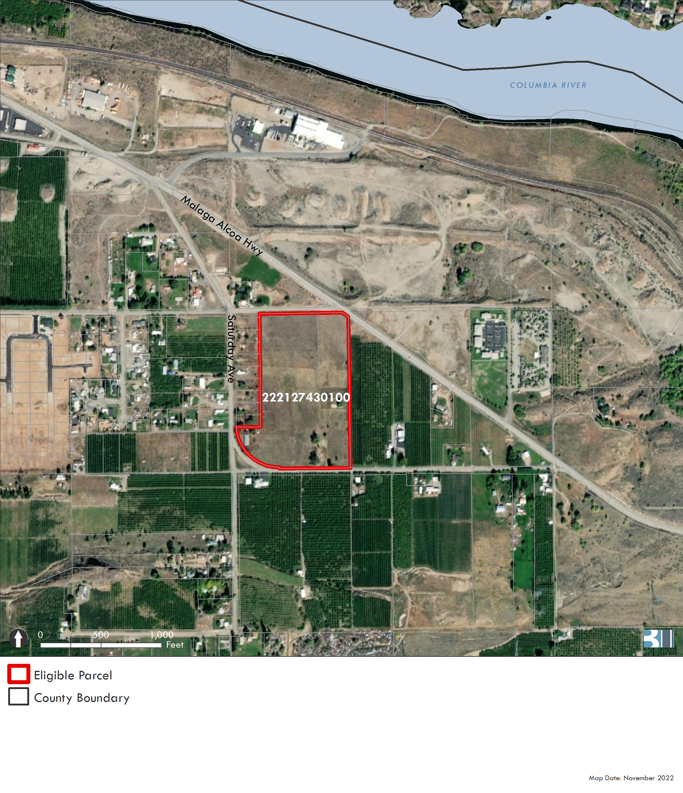
Business Incubator
Per 2020 GIS data, there is one parcel that meets the proposed requirements (20-acre minimum)

Slide 4
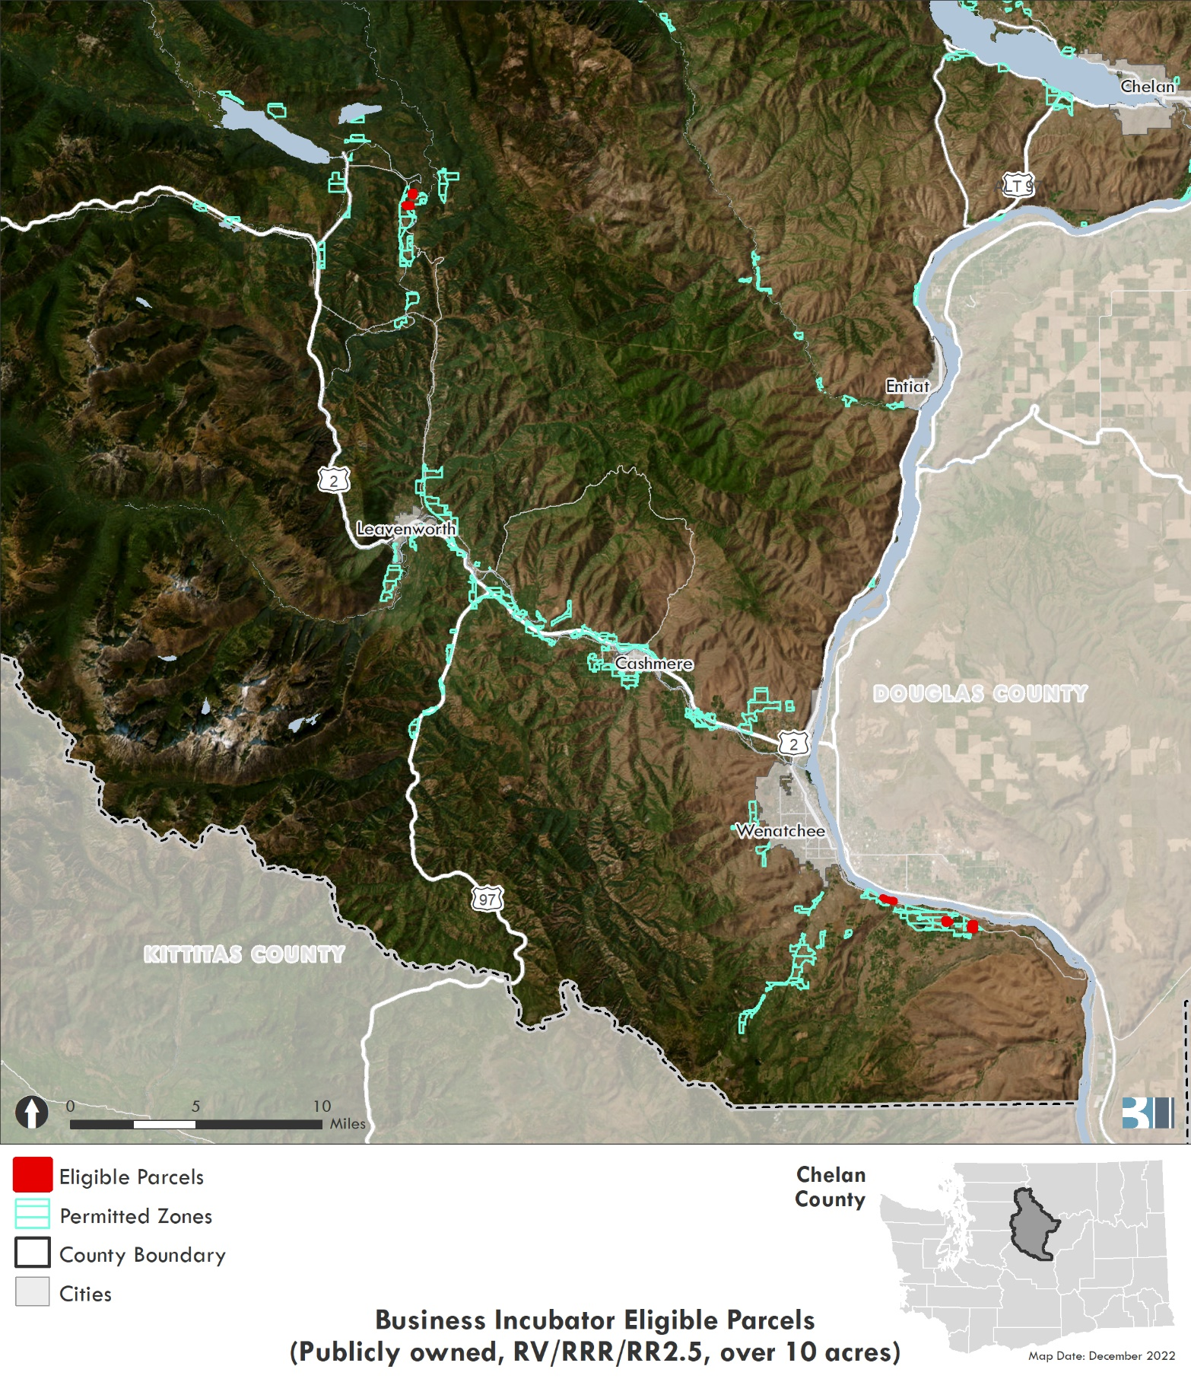
Business Incubator
The BOCC could amend this proposal to allow parcels over 10 acres in the same zones (instead of 20-acre minimum)
GIS analysis result: five parcels

Slide 5
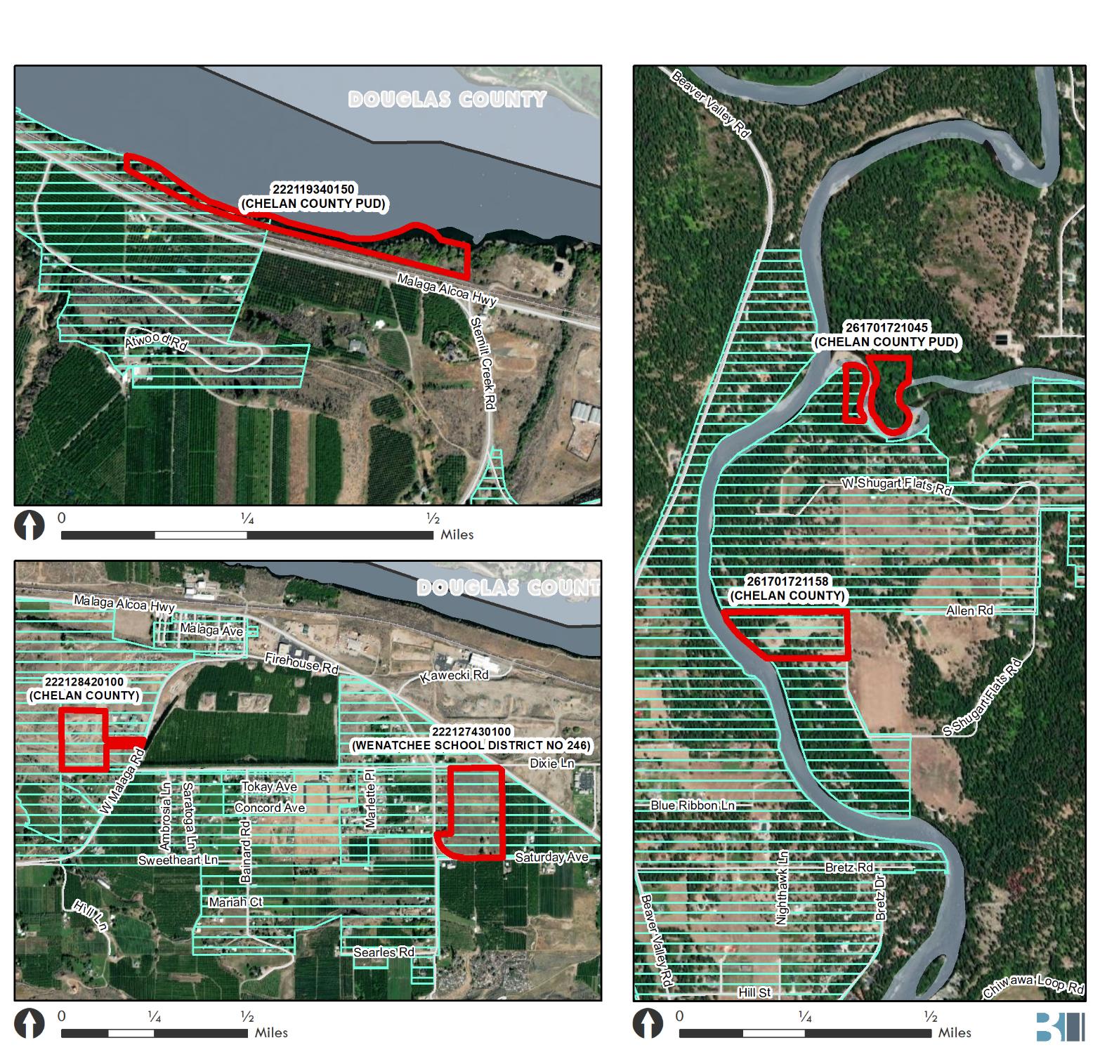
Business Incubator
Two of the five parcels are split-zoned, and the portion within the selected zones is smaller than 10-acres
The remaining three parcels that would be eligible include two in the Malaga area and one in the Plain area
Notes:
The Plain split zone parcel: other zone is RR10
The Malaga split zone parcel: other zone is RR5

Slide 6
ZTA 22-420 / CTA 22-421 Business Incubator Planning Commission recommendation: APPROVE

Slide 7
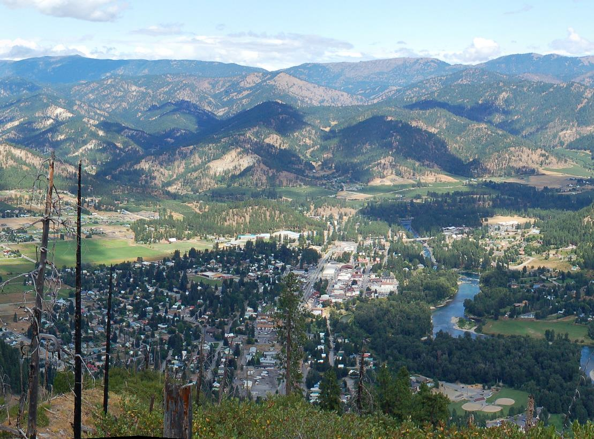
Leavenworth UGA Amendments
Interlocal Agreement June 26, 1997
County adopted Leavenworth UGA Amendments most recently in 2016
Cashmere and Entiat are not participating this year

Slide 8
Leavenworth UGA Amendments
Year | Ordinance | Description
2017 | 1542 | Update Bed & Breakfast (short-term rentals) regulations
2017 | 1543 | Update and clarify Duplex and ADU regulations
2019 | 1583 | Define zero lot line development and provide standards
2019 | 1585 | Permit cryptocurrency in the light industrial district
2019 | 1588 | Updates planned development district, and defines affordable housing
2019 | 1590 | Regulates and allows stacked parking
2019 | 1596 | Updates code for: Public facilities and utilities Development standards for manufactured homes Permitted uses in commercial districts Development code administration for Comprehensive Plan amendments and Development Regulation amendment process Official zoning map
2020 | 1610 | Amends code about short plats and major subdivisions
2021 | 1627 | Creates new district use chart, revises definitions and land use regulations

Slide 9
Leavenworth UGA Amendments
Year | Ordinance | Description
2021 | 1628 | Addresses code consistencies. Amends chapters about code interpretation and variances. Amends Supplementary Regulations regarding: Visibility obstructions Fences Accessory buildings ADUs Bed and Breakfast facilities Duplexes Building height limit exceptions Home occupations Major recreational equipment Unlicensed vehicles Yard requirements Decks, patios and balconies
2022 | 1640 | Removes lot size requirement for duplexes
2022 | 1650 | Amends Comprehensive Plan with updated Land Capacity Analysis, and updates Land Use Designations map
2022 | 1651 | Removes RL10 and RL12 zoning districts and replaces them with new R8 district, updates District Use chart and official zoning map
Notes:
Removed from consideration:
1544 (consolidating land use definitions)
1597 (Critical Areas)
1626 (Wildland-Urban Interface building standards)
1650: Amends Comprehensive Plan with updated Land Capacity Analysis, and updates Land Use Designations map. Not relevant to Chelan County but goes with 1651
1654 (Affordable housing incentive program)

Slide 10
Leavenworth UGA Amendments
Ordinance 1542
Update Bed & Breakfast (short-term rentals) regulations
Amends LMC Chapter 18.52.120 to clarify and update the Bed and Breakfast (short-term / vacation / overnight rentals in residential neighborhoods) regulations, criteria, and standards. It requires bed and breakfast facilities to be the principal residence of the property owner, sets limits on number of occupants, sets sign standards and parking requirements, and establishes an inspection and permitting process.
Notes:
Removed from consideration:
1544 (consolidating land use definitions)
1597 (Critical Areas)
1626 (Wildland-Urban Interface building standards)
1650: Amends Comprehensive Plan with updated Land Capacity Analysis, and updates Land Use Designations map. Not relevant to Chelan County but goes with 1651
1654 (Affordable housing incentive program)

Slide 11
Leavenworth UGA Amendments
Ordinance 1543
Update and clarify Duplex and ADU regulations
Updates and clarifies ADU and Duplex regulations in LMC 18.20, 18.21, 18.22, and 18.23 (permitted and conditional uses in RL6, RL12, Multifamily Residential, and RL10 districts). It allows ADUs as a permitted use in these districts, and sets requirements including non-transient use, a limit of one ADU per home site, minimum one parking space, and maximum 1,200 square feet. The ordinance requires a minimum lot size of 12,000 square feet for duplexes.
Notes:
Removed from consideration:
1544 (consolidating land use definitions)
1597 (Critical Areas)
1626 (Wildland-Urban Interface building standards)
1650: Amends Comprehensive Plan with updated Land Capacity Analysis, and updates Land Use Designations map. Not relevant to Chelan County but goes with 1651
1654 (Affordable housing incentive program)

Slide 12
Leavenworth UGA Amendments
Ordinance 1583
Define zero lot line development and provide standards
Defines zero lot line development in LMC Chapter 21.90, and amends Chapter 18.24.090 to provide standards for yards, setbacks, lot coverage, and design articulation.
Notes:
Removed from consideration:
1544 (consolidating land use definitions)
1597 (Critical Areas)
1626 (Wildland-Urban Interface building standards)
1650: Amends Comprehensive Plan with updated Land Capacity Analysis, and updates Land Use Designations map. Not relevant to Chelan County but goes with 1651
1654 (Affordable housing incentive program)

Slide 13
Leavenworth UGA Amendments
Ordinance 1585
Permit cryptocurrency in the light industrial district
Defines cryptocurrency mining in LMC Chapter 21.90.030, and amends Chapter 18.45.20 to permit cryptocurrency mining facilities in the light industrial district and requires verification of meeting Chelan County PUD requirements, electrical consumption impacts, and a permit from Washington State Department of Labor and Industries.
Notes:
Removed from consideration:
1544 (consolidating land use definitions)
1597 (Critical Areas)
1626 (Wildland-Urban Interface building standards)
1650: Amends Comprehensive Plan with updated Land Capacity Analysis, and updates Land Use Designations map. Not relevant to Chelan County but goes with 1651
1654 (Affordable housing incentive program)

Slide 14
Leavenworth UGA Amendments
Ordinance 1588
Updates planned development district, and defines affordable housing
Updates Chapter 18.40 to set requirements for residential or multiple-use Planned Development as a conditional use, including public benefit, perimeter transitions, minimum site size and scope, road improvements, density, setbacks, height limits, maximum site coverage, parking, recreation areas, and other characteristics.
Notes:
Removed from consideration:
1544 (consolidating land use definitions)
1597 (Critical Areas)
1626 (Wildland-Urban Interface building standards)
1650: Amends Comprehensive Plan with updated Land Capacity Analysis, and updates Land Use Designations map. Not relevant to Chelan County but goes with 1651
1654 (Affordable housing incentive program)

Slide 15
Leavenworth UGA Amendments
Ordinance 1590
Regulates and allows stacked parking
Defines stacked parking in Chapter 21.90.030 and sets design requirements. It permits stacked parking in General Commercial, Central Commercial, Tourist Commercial, Residential Low Density RL6, RL10, and RL12, and Multifamily Residential districts.
Notes:
Removed from consideration:
1544 (consolidating land use definitions)
1597 (Critical Areas)
1626 (Wildland-Urban Interface building standards)
1650: Amends Comprehensive Plan with updated Land Capacity Analysis, and updates Land Use Designations map. Not relevant to Chelan County but goes with 1651
1654 (Affordable housing incentive program)

Slide 16
Leavenworth UGA Amendments
Ordinance 1596
Multiple code updates
Chapter 14.14 and 17.020.070 — Concurrency for public facilities and utilities
14.16.080 — Manufactured home standards
18.28.020, 18.32.020, and 18.44.020 — Permitted and conditional uses in the General Commercial, Central Commercial, and Tourist Commercial districts.
Development code administration:
21.31.030 — General time frame for Comprehensive Plan amendments
21.35.010 — Initiation of development regulation and zoning map amendments
21.03.030 — City Council review of recommendations of the Planning Commission
18.12.010 — Official zoning map amendments
18.12.040 — Penalty for unauthorized change of the official zoning map
18.12.050 — Official zoning map shall be maintained at City Hall
Notes:
Removed from consideration:
1544 (consolidating land use definitions)
1597 (Critical Areas)
1626 (Wildland-Urban Interface building standards)
1650: Amends Comprehensive Plan with updated Land Capacity Analysis, and updates Land Use Designations map. Not relevant to Chelan County but goes with 1651
1654 (Affordable housing incentive program)

Slide 17
Leavenworth UGA Amendments
Ordinance 1610
Amends code for short plats and major subdivisions
Chapter 17.080.010 and 17.08.070, regulating Short Plats, divisions of land into nine or fewer plots
17.12.010 — Chapter applies to Major Subdivisions of land into ten or more plots
21.90.030 — Amending definitions of final short plat, final plat, major subdivision, and short subdivision
Notes:
Removed from consideration:
1544 (consolidating land use definitions)
1597 (Critical Areas)
1626 (Wildland-Urban Interface building standards)
1650: Amends Comprehensive Plan with updated Land Capacity Analysis, and updates Land Use Designations map. Not relevant to Chelan County but goes with 1651
1654 (Affordable housing incentive program)

Slide 18
Leavenworth UGA Amendments
Ordinance 1627
Creates new district use chart, revises definitions and land use regulations
Notes:
Removed from consideration:
1544 (consolidating land use definitions)
1597 (Critical Areas)
1626 (Wildland-Urban Interface building standards)
1650: Amends Comprehensive Plan with updated Land Capacity Analysis, and updates Land Use Designations map. Not relevant to Chelan County but goes with 1651
1654 (Affordable housing incentive program)

Slide 19
Leavenworth UGA Amendments
Ordinance 1628
Addresses code consistencies. Amends chapters about code interpretation and variances. Amends Supplementary Regulations regarding:
18.35.005 — Purpose and Applicability of supplementary regulations
18.35.010 — Visibility obstructions
18.35.020 — Fences, walls, and hedges
18.35.030 — Accessory buildings
18.35.035 — Accessory Dwelling Units
18.35.038 — Bed and Breakfast facilities
18.35.040 — Prohibiting more than one principal structure in low-density residential districts
18.35.045 — Duplex dwellings
18.35.050 — Exceptions to building height limits
18.35.060 — Home occupations
18.35.070 — Major recreational equipment
18.35.080 — Unlicensed vehicles: parking and storage restrictions
18.35.090 — Yard modification requirements
18.35.100 — Decks, patios, and balconies
Notes:
Removed from consideration:
1544 (consolidating land use definitions)
1597 (Critical Areas)
1626 (Wildland-Urban Interface building standards)
1650: Amends Comprehensive Plan with updated Land Capacity Analysis, and updates Land Use Designations map. Not relevant to Chelan County but goes with 1651
1654 (Affordable housing incentive program)

Slide 20
Leavenworth UGA Amendments
Ordinance 1640
Removes lot size requirement for duplexes
Removes minimum lot size requirement for duplexes, making it the same as for single family dwellings, in RL6, RL12, and RL10 districts. It amends Chapter 21.90 definitions for duplex and removes duplexes as a conditional use in Chapter 18.52.130.
Note: RL12 and RL10 districts have been removed from the code and replaced by the new R8 district (Ordinance 1650)
Notes:
Removed from consideration:
1544 (consolidating land use definitions)
1597 (Critical Areas)
1626 (Wildland-Urban Interface building standards)
1650: Amends Comprehensive Plan with updated Land Capacity Analysis, and updates Land Use Designations map. Not relevant to Chelan County but goes with 1651
1654 (Affordable housing incentive program)

Slide 21
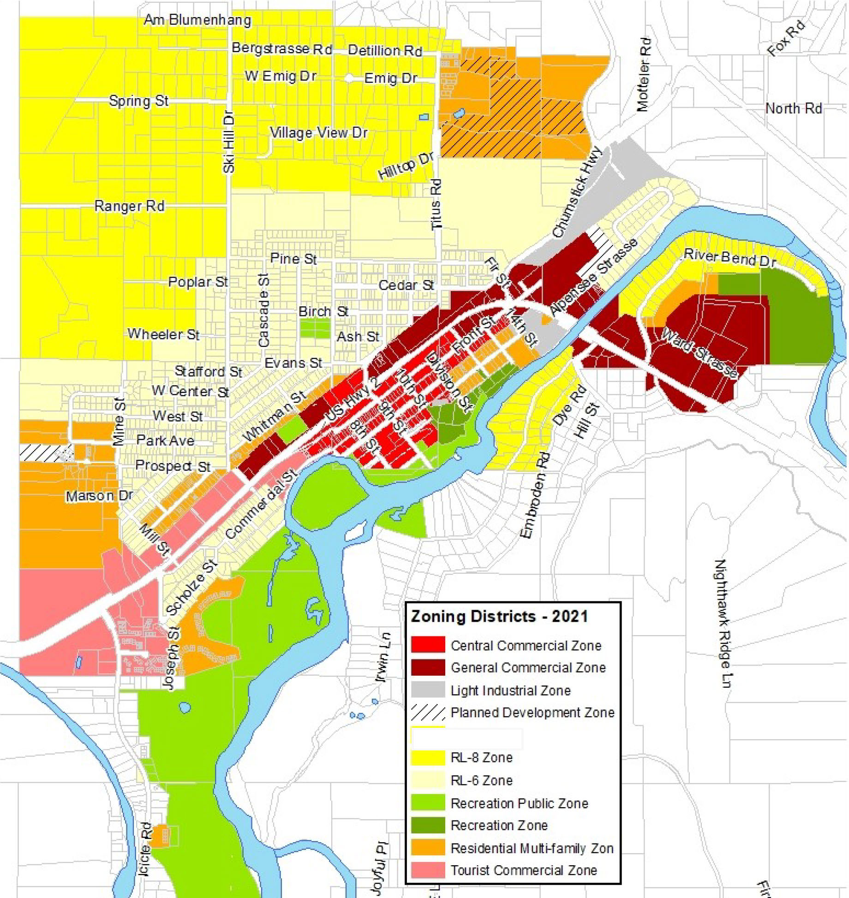
Leavenworth UGA Amendments
Ordinance 1650
Amends Comprehensive Plan with updated Land Capacity Analysis, and updates Land Use Designations map
New Land Capacity Analysis and 2021
Land Use Designations map including new R8 zone. The related Ordinance 1651 amends the zoning code and adopts the new official zoning map.
Notes:
Removed from consideration:
1544 (consolidating land use definitions)
1597 (Critical Areas)
1626 (Wildland-Urban Interface building standards)
1650: Amends Comprehensive Plan with updated Land Capacity Analysis, and updates Land Use Designations map. Not relevant to Chelan County but goes with 1651
1654 (Affordable housing incentive program)

Slide 22
Leavenworth UGA Amendments
Ordinance 1651
Removes RL10 and RL12 zoning districts and replaces them with new R8 district, updates District Use chart and official zoning map
Amends Chapter 18.21. The R8 district permits single family residences, duplexes, and accessory dwelling units, with a minimum lot size of 8,000 square feet.
Notes:
Removed from consideration:
1544 (consolidating land use definitions)
1597 (Critical Areas)
1626 (Wildland-Urban Interface building standards)
1650: Amends Comprehensive Plan with updated Land Capacity Analysis, and updates Land Use Designations map. Not relevant to Chelan County but goes with 1651
1654 (Affordable housing incentive program)

Slide 23
Leavenworth UGA Amendments
Notes:
Removed from consideration:
1544 (consolidating land use definitions)
1597 (Critical Areas)
1626 (Wildland-Urban Interface building standards)
1650: Amends Comprehensive Plan with updated Land Capacity Analysis, and updates Land Use Designations map. Not relevant to Chelan County but goes with 1651
1654 (Affordable housing incentive program)

Slide 24
Leavenworth UGA Amendments
Ordinance 1654
Affordable Housing Incentive Program
Amends Chapter 18.42 to establish the Affordable Housing Incentive Program, with the intent to encourage development of housing units that are affordable to service industry workers and others with low or moderate incomes. Includes changes to density, lot coverage, front yard setbacks, alley access, parking, and design standards.
Planning Commission recommendation: approve, with removal of reference to 18.42.030
Notes:
Removed from consideration:
1544 (consolidating land use definitions)
1597 (Critical Areas)
1626 (Wildland-Urban Interface building standards)
1650: Amends Comprehensive Plan with updated Land Capacity Analysis, and updates Land Use Designations map. Not relevant to Chelan County but goes with 1651
1654 (Affordable housing incentive program)

Slide 25
ZTA 22-419 Leavenworth Urban Growth Area Amendments Planning Commission recommendation: APPROVE, with the exception of removing reference to 18.42.030 in City of Leavenworth Ord #1654

Slide 26
Next Steps
BOCC hearing: January 31st

Slide 27
Appendix

Slide 28
Business Incubator
Examples of similar projects in other areas:
Business Development Center (Kittitas County)
Spice Bridge (Tukwila)
Rutgers Food Innovation Center (Bridgeton, N.J.)
Union Kitchen (Washington, D.C.)
Spice Bridge (Tukwila). Photos from Food Innovation Network.

Slide 29
Process Updates
SEPA determinations were issued October 12th (14-day comment period ended October 26th — no public comments received)
60-day Commerce review was submitted in early October
Planning Commission hearings were on October 26th and December 14th
BOCC hearing is expected to be in January (date to be confirmed)
Notes:
To discuss any comments received if any come in prior to hearing.

Slide 30
Draft Proposals from 2022 Docket
CPA 22-089: RR2.5 to RW (Chelan/Manson area)
CPA 22-105: RR5 to RR2.5 (Chelan area)
CPA 22-106: RR5 to RR2.5 (Plain/Lake Wenatchee area)
CPA 22-107: RR10 & RR2.5 to RR2.5 (Leavenworth area)
CPA-22-418 (Docket #9): CIP Annual Update for County Budget
ZTA-22-420/CPA-22-421 (Docket #5): Business Incubator, Open Market
ZTA-22-419 (Docket #7): Leavenworth UGA Amendments

Slide 31
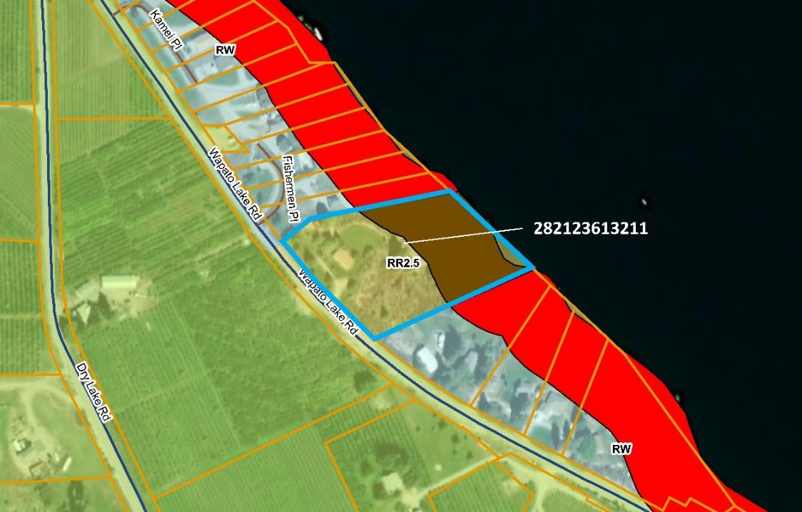
CPA 22-089: RR2.5 to RW (Chelan/Manson area)
Parcel: 282123613211
4720 Wapato Lake Rd
3.73 acres
Intent to add 2-3 additional waterfront dwelling units
Notes:
- Parcel number is incorrect on the application – Cherie Warren

Slide 32
CPA 22-089: RR2.5 to RW (Chelan/Manson area) Planning Commission recommendation: APPROVE with correction to parcel number and PID

Slide 33
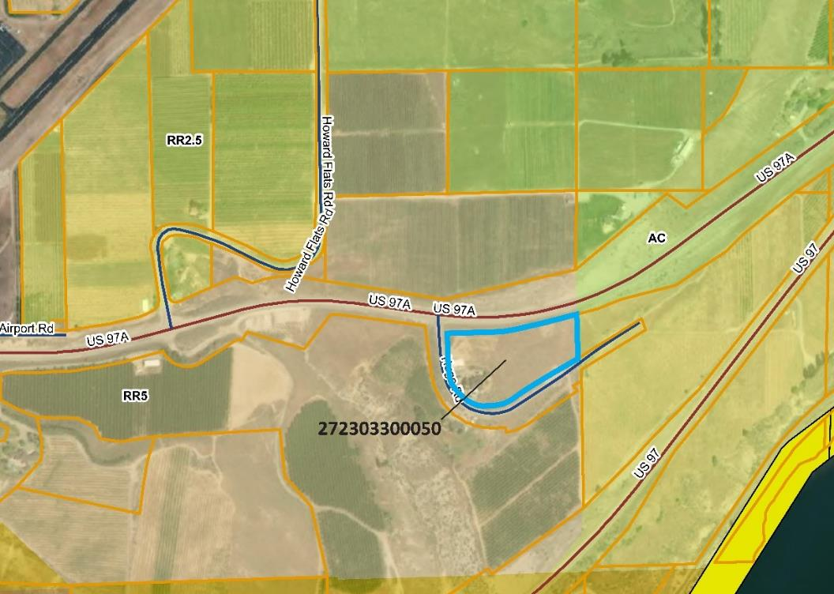
CPA 22-105: RR5 to RR2.5 (Chelan area)
Parcel: 272303300050
25 Hugo Road
5.0 acres
Intent to divide the parcel into two smaller parcels

Slide 34
CPA 22-105: RR5 to RR2.5 (Chelan area) Planning Commission recommendation: APPROVE

Slide 35
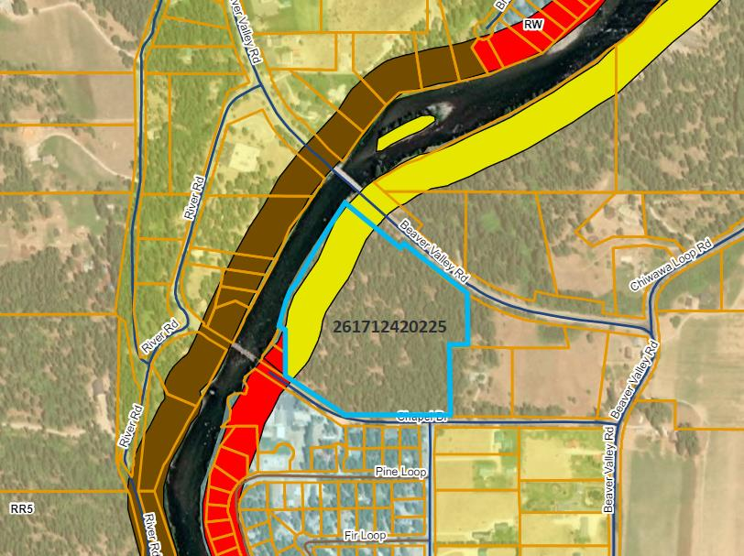
CPA 22-106: RR5 to RR2.5 (Plain/Lake Wenatchee area)
Parcel: 261712420225
19088 Beaver Valley Road
19.44 acres
Intent to rezone one parcel from RR5 (rural residential/resource) to RR2.5

Slide 36
CPA 22-106: RR5 to RR2.5 (Plain/Lake Wenatchee area) Planning Commission recommendation: APPROVE
Notes:
To share staff report on screen to discuss detailed findings prior to motion.

Slide 37
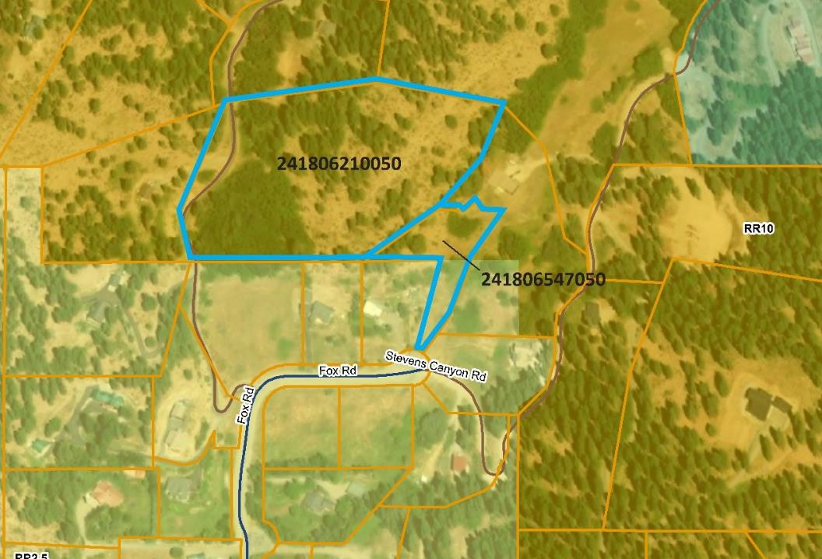
CPA 22-107: RR10 & RR2.5 to RR2.5 (Leavenworth area)
Parcels: 241806210050, 241806547050
10690 Fox Road
7.76 acres
Intent to rezone two parcels to RR2.5. One parcel is currently RR10, and the other is split zoned RR10/RR2.5.

Slide 38
CPA 22-107: RR10 & RR2.5 to RR2.5 (Leavenworth area) Planning Commission recommendation: APPROVE

Slide 39
CIP Annual Update
Text amendment to the Capital Facilities Element
Required to meet GMA provisions
Update the six-year Capital Improvement Plan (CIP) for 2023–2028
Describes public capital expenditures and funding sources (e.g. Real Estate Excise Tax)
County Administrator requests Departments provide list/schedule

Slide 40
CIP Annual Update: Project List
Cashmere Dryden Airport
Rehabilitate hangar taxilane
Environmental Assessment for Obstruction Removal (RWY 7), prep for runway shift project
Transient Parking / Hangar Site Development
Obstruction Removal — General
Property Acquisition RWY 25
Property Acquisition RWY 7
Commissioner’s Office
Jail Facilities Debt Service
County Expo Center
Building Upgrades
Carnival Lot Improvements
Ground Improvement/Electric/Asphalt
RV Park Improvement
Arena Improvements

Slide 41
CIP Annual Update: Project List
Facilities Department
Parking Lot Crack Sealing
Boilers — 1974 Courthouse
Campus-wide Access Control
Telephone System Upgrade
HVAC & Control Systems Upgrade (316 building)
Facilities Signage (Courthouse)
Carpet — Campus
Marble Restoration (Courthouse)
Fire Alarm System Update
Vestibule
Elevator Modernization (Law & Justice)
Security Systems Upgrade
HVAC Upgrade/ Replacement (West Annex)
Campus Network Infrastructure

Slide 42
CIP Annual Update: Project List
Ohme Gardens
Irrigation Pump Station
Parking Lot Improvements
Ox Yoke Lodge Renovation
Tree Work
Lower Lawn Stage
Public Works
Totem Pole Road
Dryden Transfer Station – Second Tip Floor
Chelan Transfer Station Upgrades
Vegecide Truck Wash Facility
Wenatchee District Shop Replacement
Road Rehabilitation
Road District Sheds: Accessibility, Shop Lighting, and Electrical Efficiency Upgrades

Slide 43
CIP Annual Update: Project List
Regional Justice Center
CCRJC Kitchen and Records/Control Remodel
Justice Facilities Improvement/Rehab
Operational — Shower Improvements
Operational — Remodel Records Area/ Create Office
Safety — Camera Installation — Seg Cells
Safety — Railing Install
Safety — Remodel H6 &H7
Operational — SWF Conversion/Remodel
Booking Area Remodel
Additional Padded Cell
Additional Holding Cells
EAC Key Cards
Sheriff
Emergency Operations Center

Slide 44
CIP Annual Update Planning Commission recommendation: APPROVE

