Slide 1

Chelan County
Transportation Element Update
Staff Workshop

Slide 2
Overview of Topics
GMA Requirements
Transportation Planning Approaches & Level of Service
Goals Update
Next Steps
Replace with picture of chelan

Slide 3
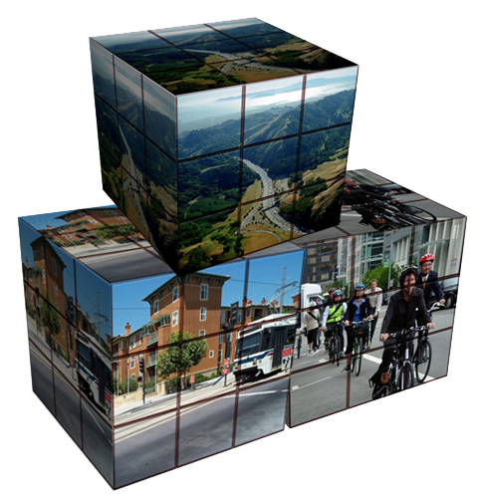
What is a Transportation Element?
Required element of County’s Comprehensive Plan per the Growth Management Act (GMA)
Consider various modes
Level of Service
Needed facilities and services (20 yrs)
Funding program

Slide 4
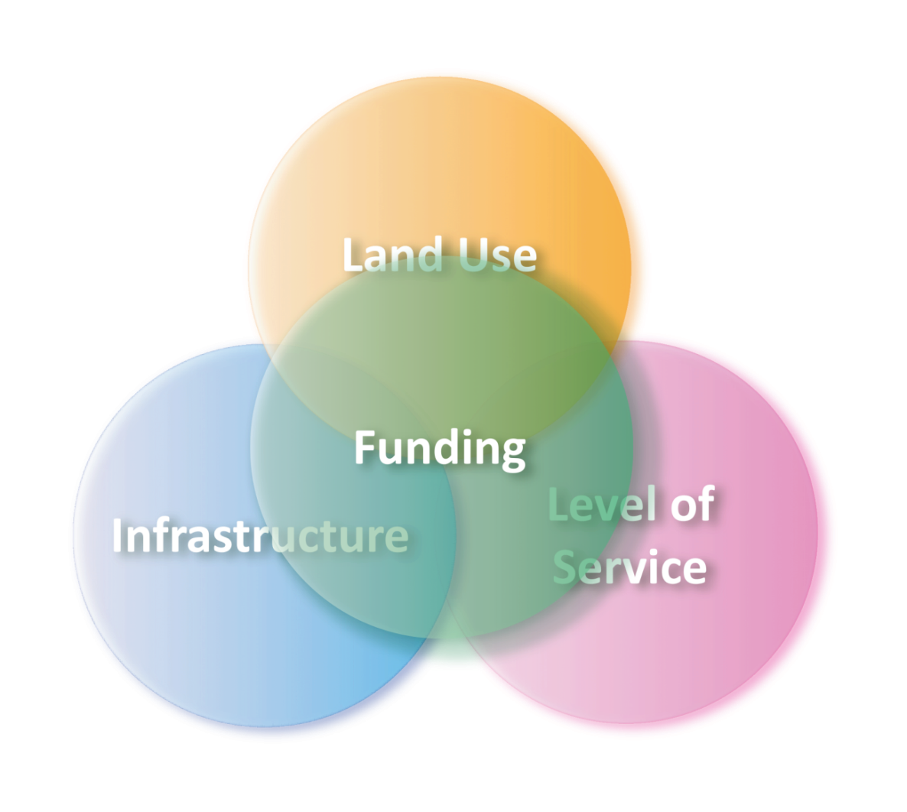
GMA Requirements for Transportation
Land use assumptions align with travel demand forecasts
Intergovernmental coordination
Level of service policies established for all modes
Facility recommendations align with level of service objectives
Financially constrained

Slide 5
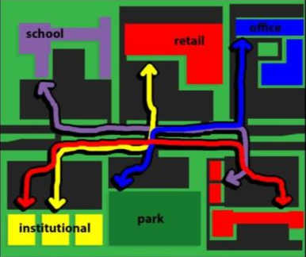
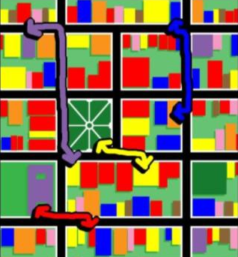
Key Principle: Connectivity
Conventional:
  Disconnected, Separate Uses
  Overall less capacity
  Higher number of crashes*
  Not ped/bike/transit friendly
  Slower emergency response**
Traditional:
  Connected, Mixed Uses
  Overall more capacity
  Fewer, less severe crashes
  Multiple direct travel options
  Ped/bike/transit friendly
  Fewer/shorter auto trips
  Faster emergency response**
Sources: * Research in 24 cities, 130,000 crashes
** City of Charlotte, NC

Slide 6
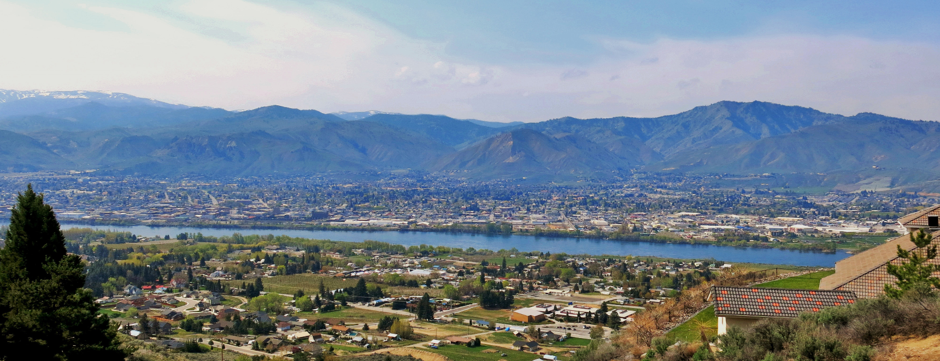
Key Principle: Sustainable
Be planned with consideration of environmental, social and economic issues.
Notes:
http://static1.squarespace.com/static/533203c6e4b00ce9525a703e/t/5616ea7ce4b03a60350065da/1444342396535/Transportation2040_RTP_Final_LowRes.pdf

Slide 7
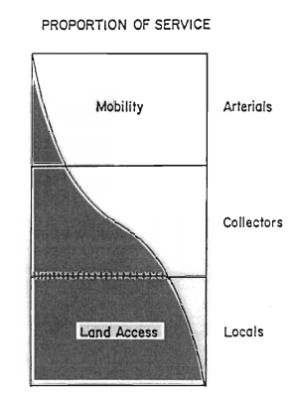
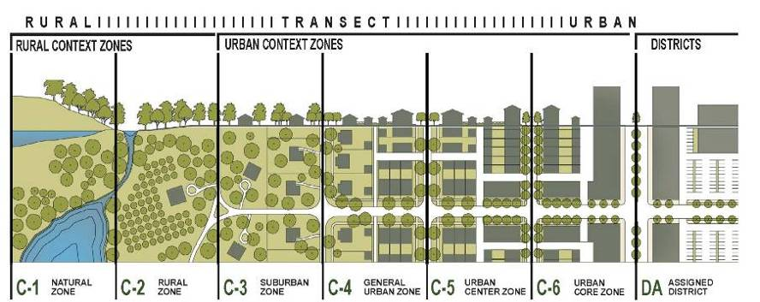
Functional Classification and Context
Context Factors
  Land Use Type
  Development Densities
  Form (e.g. height and setback)
  Corridor Users
Conventional
New Typologies

Slide 8
Chelan County’s Existing Level of Service Policy
Measured during the PM peak hour (4-6pm) for intersections along State Routes, County arterials & collectors:
LOS C or better- rural areas
LOS D or better- urban areas
Level of Service | Description
A | Free-flowing conditions.
B | Stable operating conditions.
C | Stable operating conditions, but individual motorists are affected by the interaction with other motorists.
D | High density of motorists, but stable flow.
E | Near-capacity operations, with significant delay and low speeds.
F | Over capacity, with delays.

Slide 9
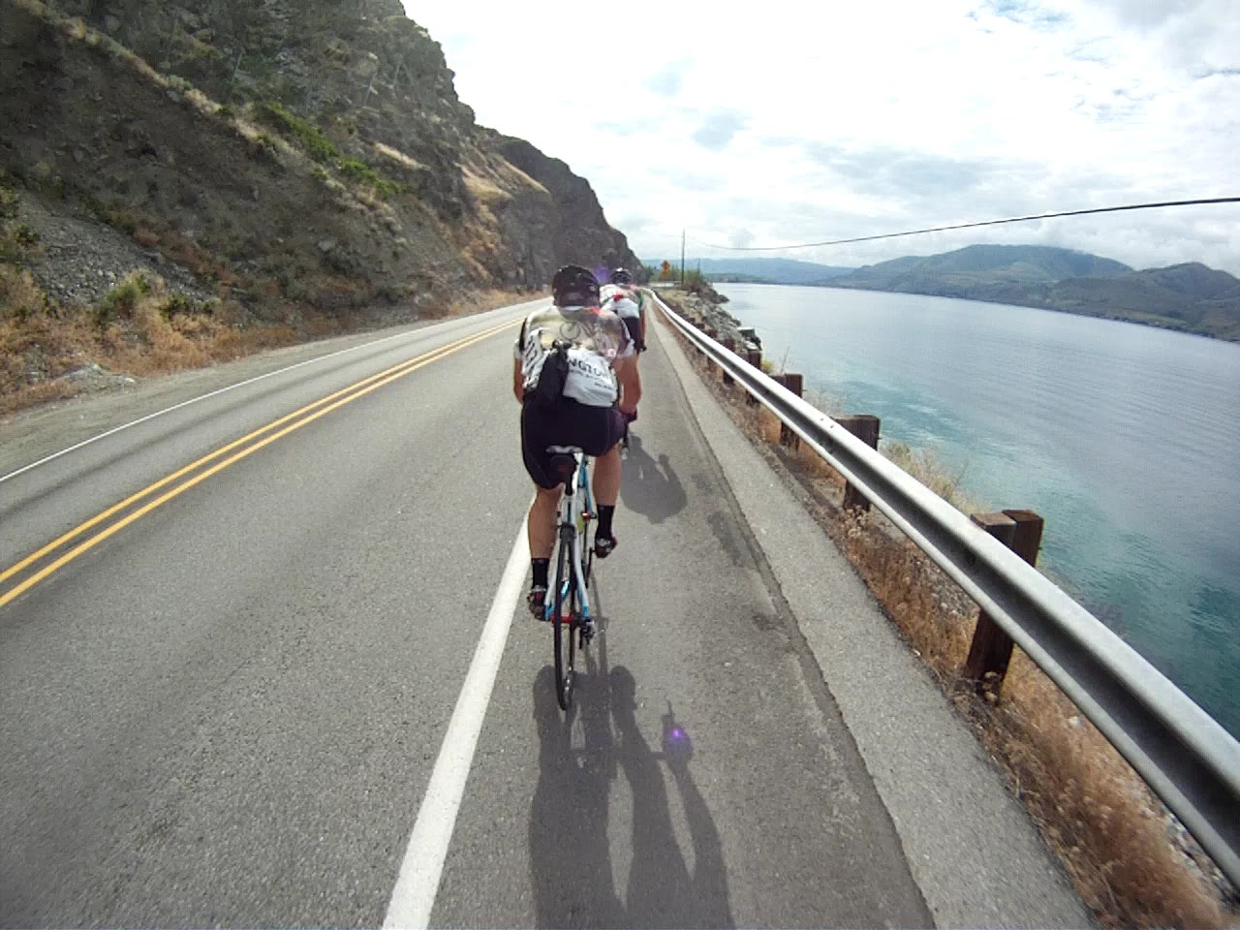
Multimodal Level of Service
Notes:
http://3.bp.blogspot.com/-1vrVfSjT2OY/T-d-teGf3WI/AAAAAAAAH9A/qmVEnS5N6Os/s1600/Snapshot%252839%2529.bmp

Slide 10
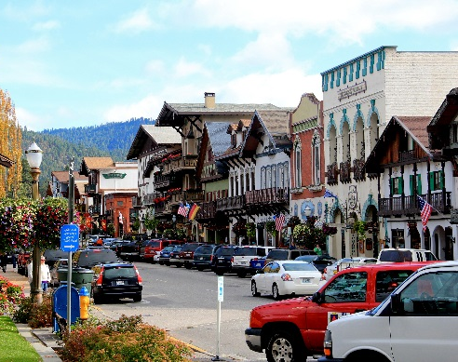
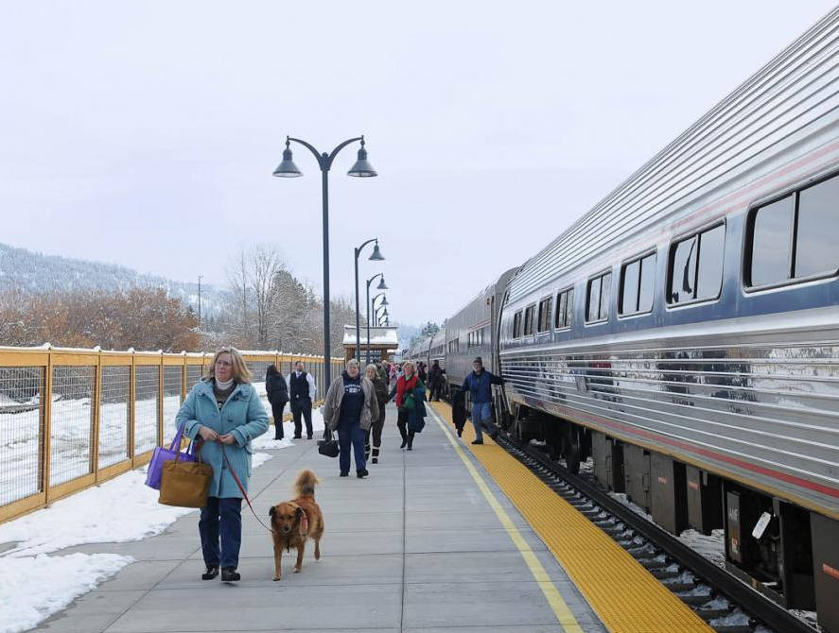
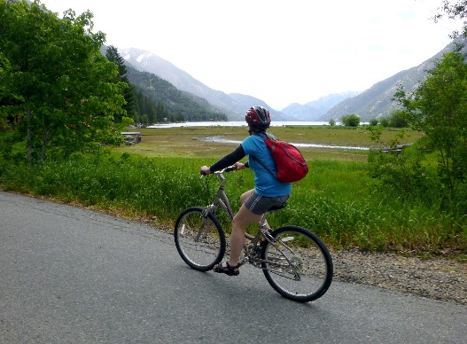
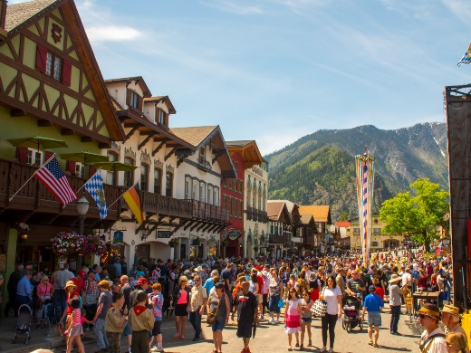
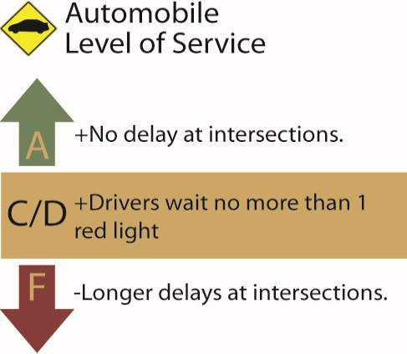
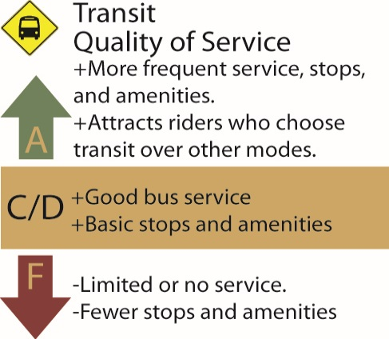
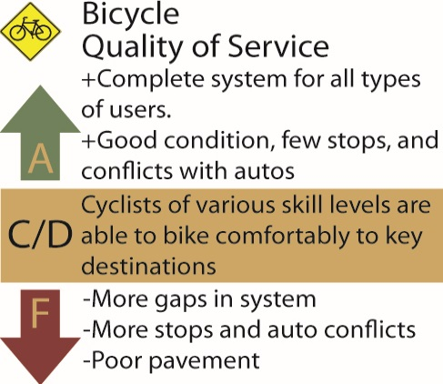
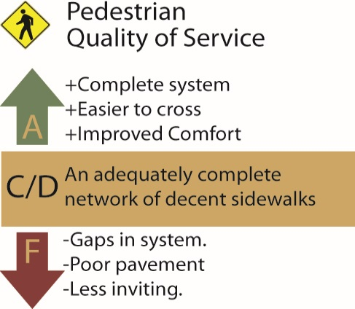
Multimodal Quality of Service
Balance and prioritize design to meet street’s purpose
Notes:
https://maplessadventures.files.wordpress.com/2012/10/img_9997.jpg
http://www.leavenworth.org/files/styles/large/public/DSC_7550.jpg?itok=9DbHHycJ
http://www.columbian.com/wp-content/uploads/2015/08/Outdoors_Chelan_Lakeshore2.jpg
http://www.icicle.tv/wp-content/uploads/2015/05/maifest-61.jpg

Slide 11
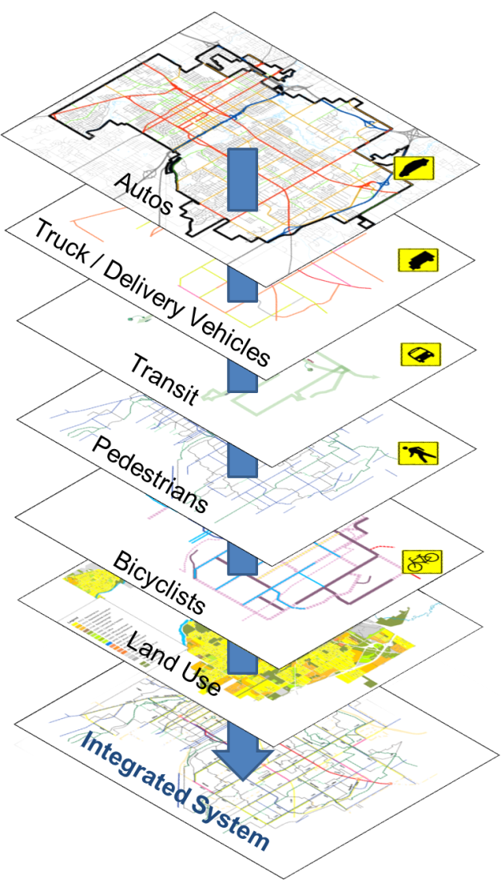
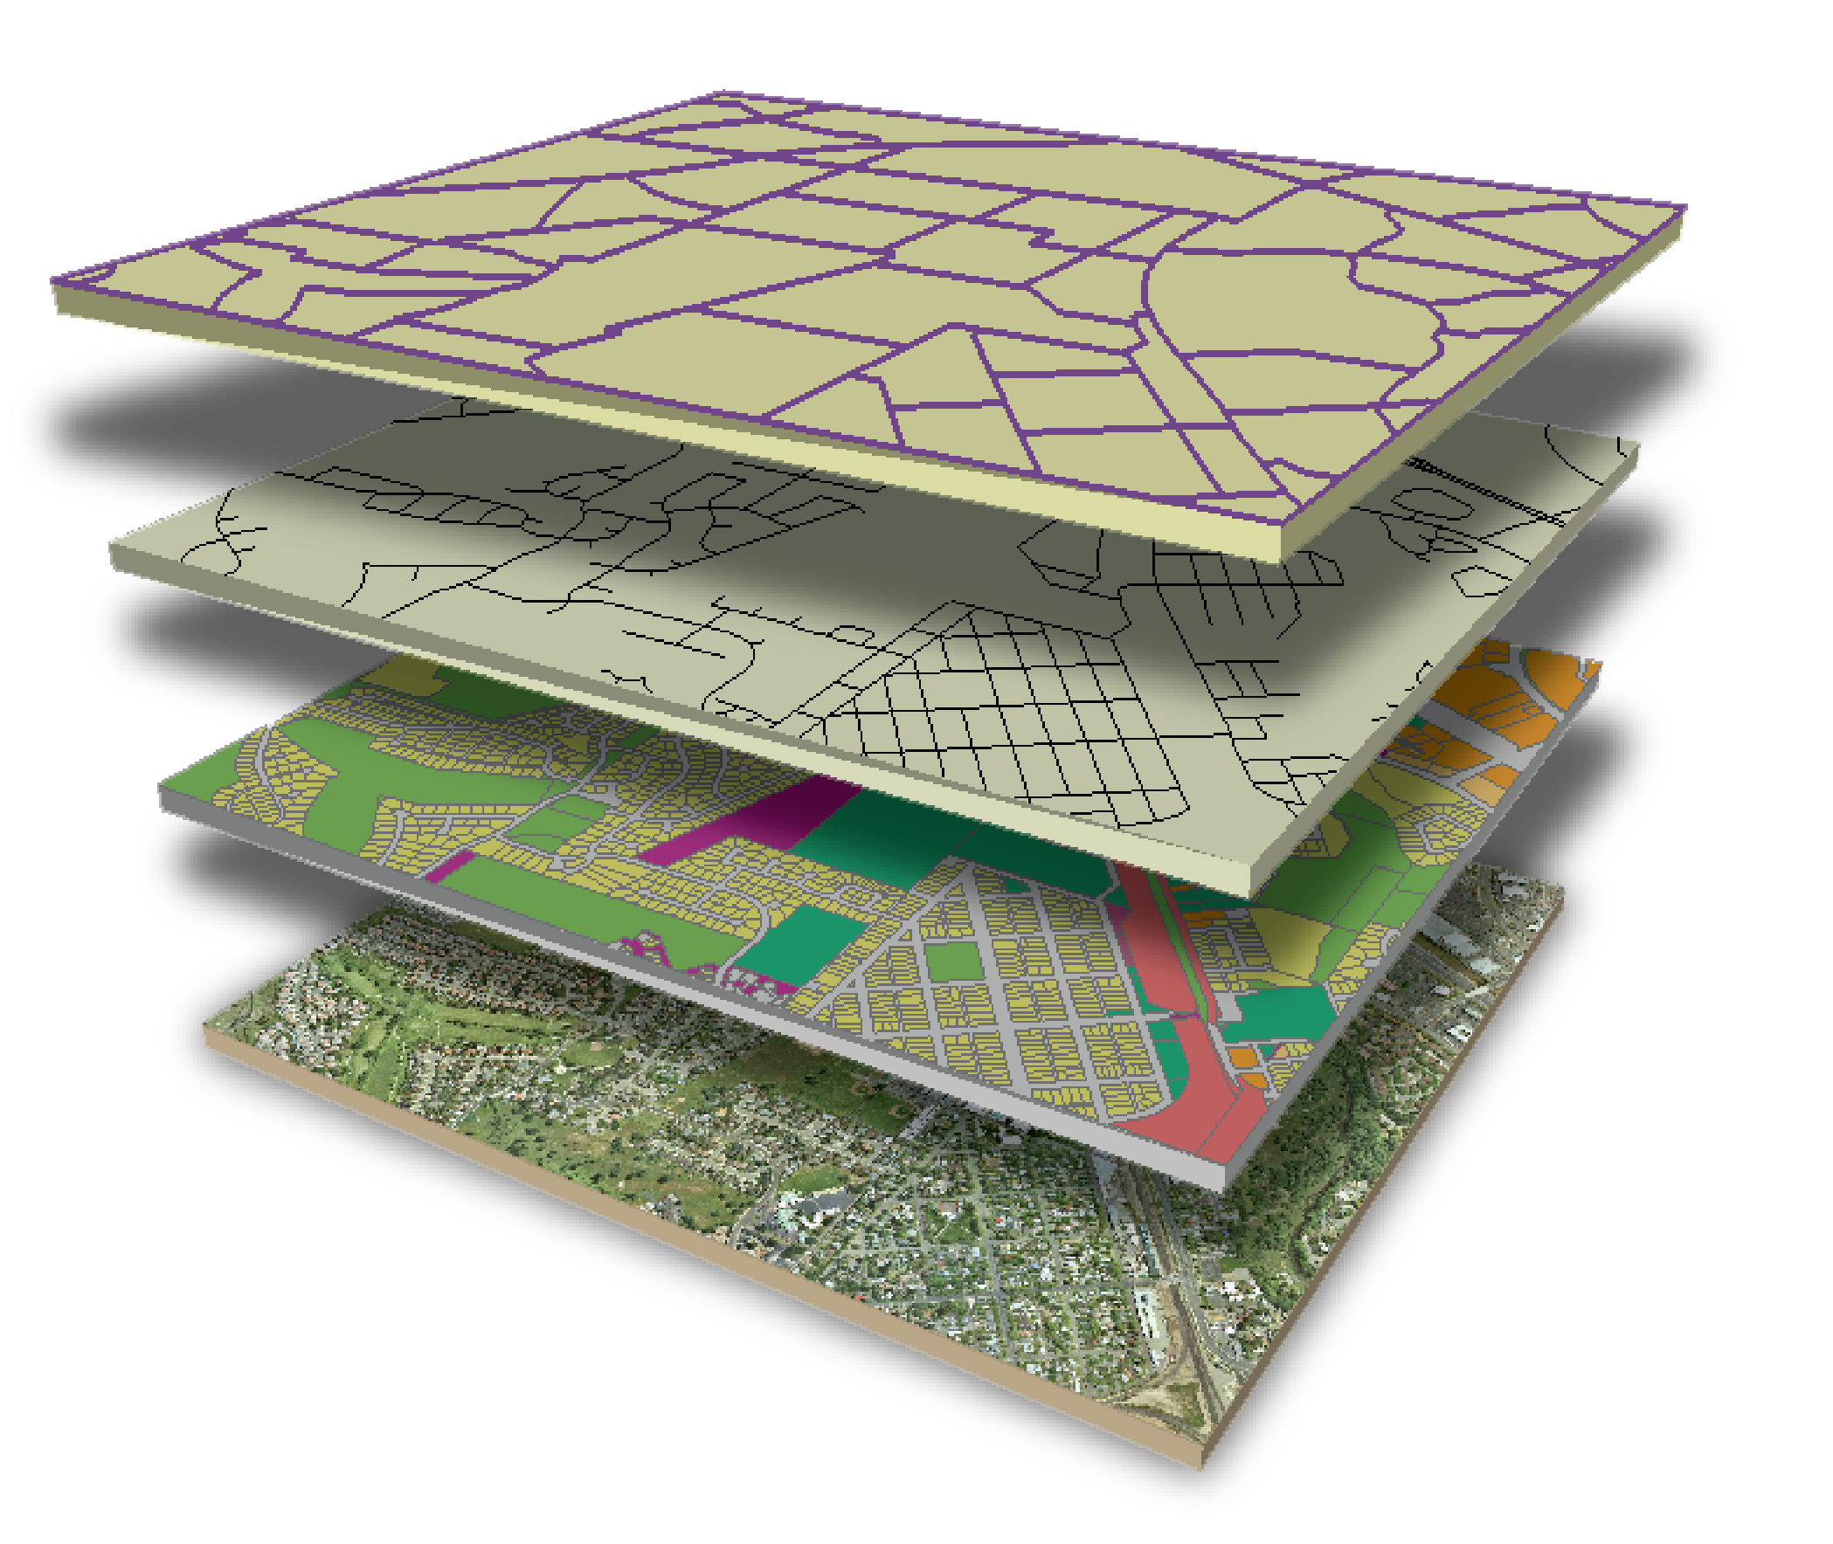
Complete Networks,
Rather than Complete Streets
Balanced, layered multimodal networks that serve pedestrians, bicyclists, transit riders, motorists, and freight/goods movement.

Slide 12
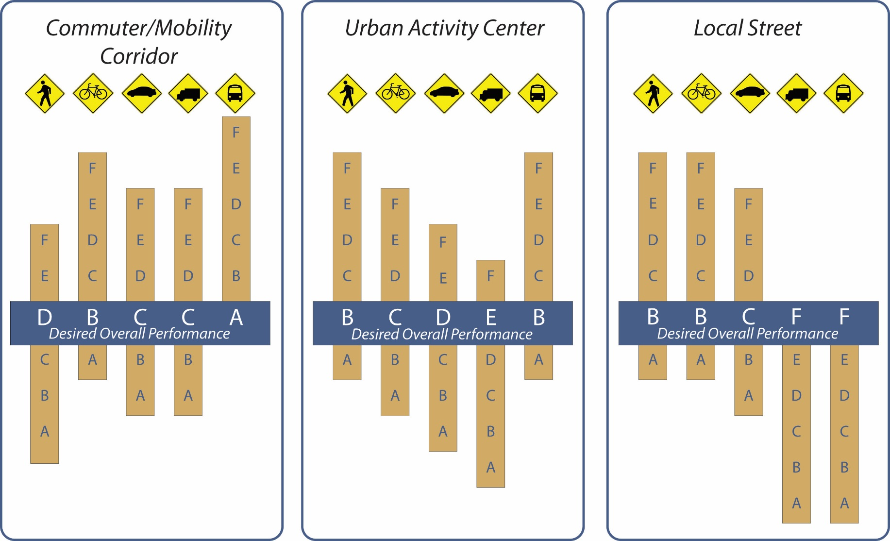
Multimodal Quality of Service
Commuter/Mobility Corridor
Community Core
Local Street

Slide 13
Revisit Transportation Element’s Goals
Overall system – provide a safe, convenient, and economically functional multimodal system
Coordination and consistency – collaborative with local, regional, and state agencies, as well as with the public
Roadway system – establish an efficient, safe, and environmentally sensitive road system that supports desired development
Air transportation – maintain transportation connections with airports and small air facilities
Rail transportation – maintain and expand rail service
Freight and goods – promote efficient movement of freight and goods countywide
Non-motorized transportation – promote safe and efficient system of non-motorized facilities
Transit and Travel Demand Management – enhance transit services and implement TDM strategies to improve capacity of the transportation system
Economic development – build transportation that supports tourism and recreation as well as business and employment
Coordination with land use – establish land use policies, regulations, and designs that enhance the transportation system
Environment and energy – provide transportation facilities and services that are energy efficient and minimize adverse environmental impacts
Implementation and funding – develop an approach to prioritize and implement the transportation system over the next 20 years

Slide 14
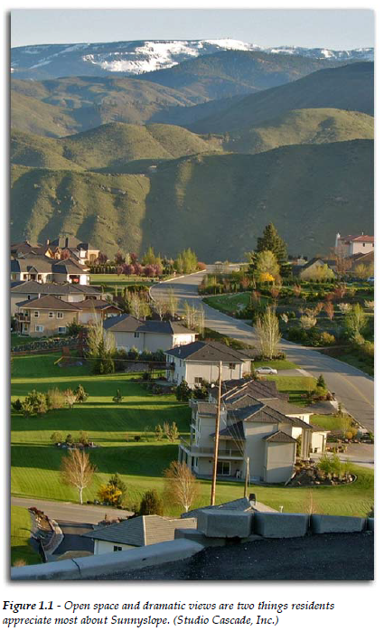
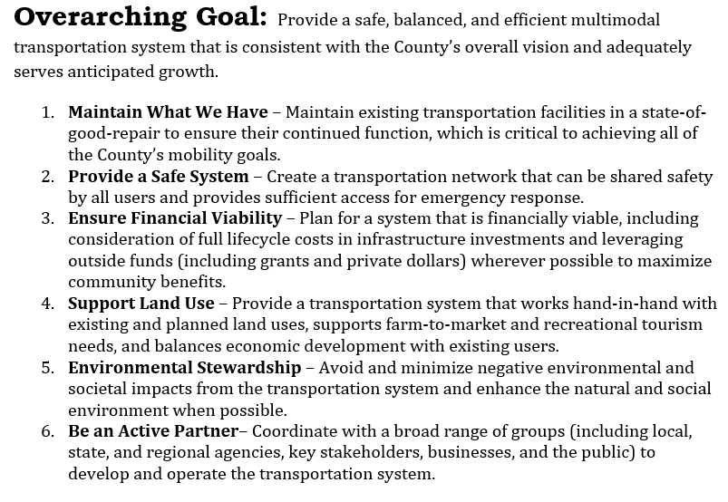
Proposed Goals for this Update

Slide 15
Proposed Goals in Context
Proposed Goals
  Maintain What We Have
  Provide a Safe System
  Support Land Use
  Environmental Stewardship
  Ensure Financial Viability
  Be an Active Partner
Existing Goals
  Overall System
  Roadway System
  Air Transportation
  Rail Transportation
  Freight and Goods
  Non-Motorized Transportation
  Transit and Travel Demand Management
  Economic Development
  Coordination with Land Use
  Environment and Energy
  Implementation and Funding
  Coordination and Consistency

Slide 16
Next Steps
Outreach to agency partners, jurisdictions, and public
Transportation needs assessment (existing and future needs)
Evaluate and prioritize draft projects
Develop a financial plan
Draft plan by late 2016

Slide 17
Questions?
Kendra Breiland
k.breiland@fehrandpeers.com

